Slide 1
COMP575 Project
NetLogo traffic with lane changing
Carl Edwards

Slide 2
Problem Solution
Investigate how cars changing lanes affect traffic by building a NetLogo model to simulate and record results.
A user configurable number of turtles are randomly place in lanes. As a car approaches another car it changes lanes or slows down otherwise it speeds up.

Slide 3
Agent algorithms
Building the dividing lines (dashed and solid).
Collision detection (turtles-on patch-ahead).
Room to pass (patch-left-and-ahead).
Avoid excessive lane changing (distance from last).

Slide 4
Interesting bits of code
repeat (world-width / (line-length + line-spacing)) [
ask dividers [
paint-line line-length line-spacing ]
]
ask dividers [ die ] ; don't need the line painting agents
-----------------------------------------------------------
to avoid-collision
set loop-counter (loop-counter + 1)
let max-iterations 100
if any? other cars-here [
forward random 3
if (loop-counter < 100) [
avoid-collision ]
]
end

Slide 5
Possible refinements and IMPROVEMENTS
Allow the number of lanes to be a user option.
Support multiple vehicle types (trucks, motorcycles).
Improve the buffer code to avoid overlaps.
Build in different driving types.
Extend the concept of a divider be more realistic and allow passing zones near on and off ramps.
Make lanes directed links to simplify code.
Change minimum plot to be moving average.
Expand data collected and plots.

Slide 6
References
NetLogo Modeling Commons:
Traffic with lane changing

Slide 7
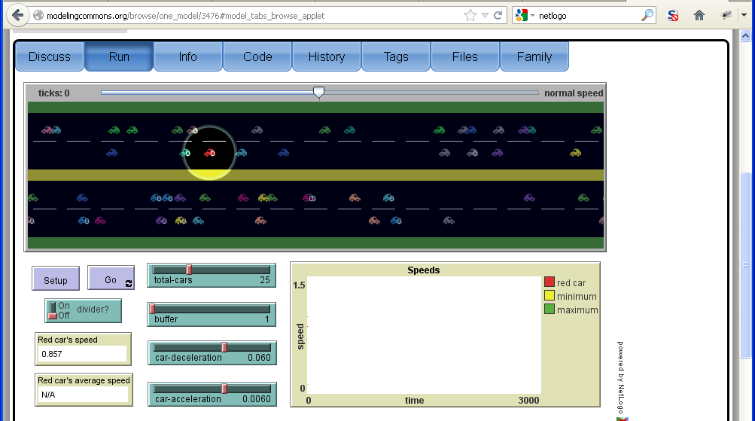
NetLogo Screen capture
Setup with passing allowed

Slide 8
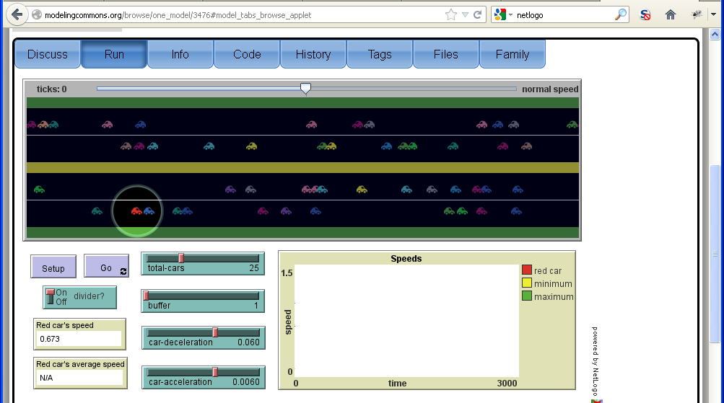
NetLogo Screen capture
Setup with divider

Slide 9
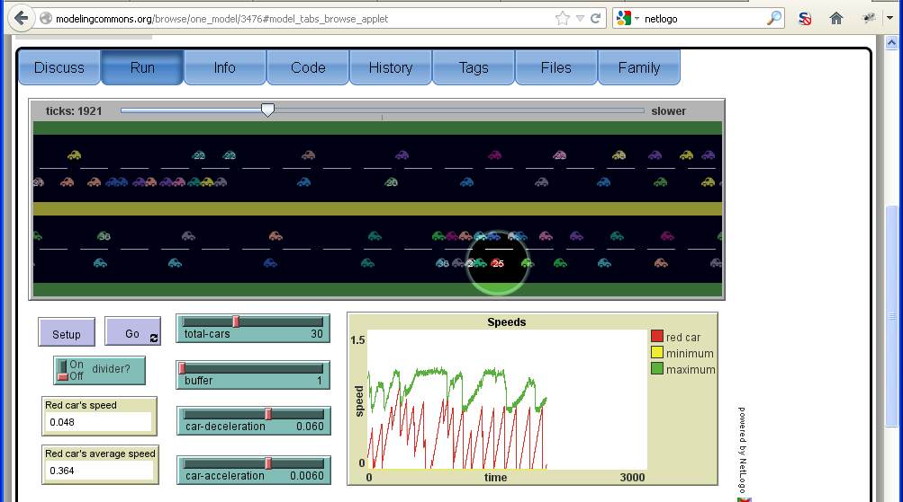
NetLogo Screen capture
View after almost 2000 ticks

