Slide 1
You Believe What?!
A Model of Belief Consolidation and Homophily in Social Networks
Jacob Kelter
EECS 372, Spring 2013

Slide 2
Driving Questions
How do beliefs spread across a network?
What role does stubbornness play in belief spread?
What mechanism lead agents on a network to sort themselves by belief?
Can a small group of stubborn agents convince a larger group of a new belief?

Slide 3
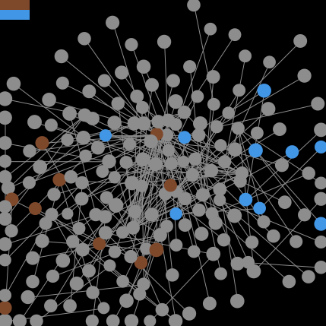
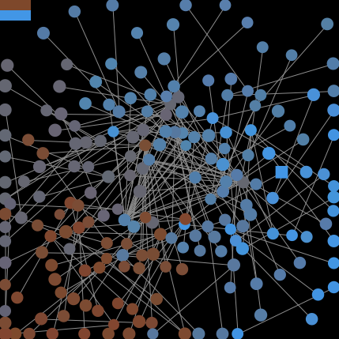
Spreading Beliefs

