Slide 1
Safe Sex Attitudes and Behaviors
lizz bartos
eecs 372, Spring 2013

Slide 2
Overview & Motivation
Model Parameters
Social network: users can control control the number and size (members) of cliques, and whether they are initialized with some inter-group links. These cliques consist of agents that primarily interact with members of the same group.
STI: users can control the likelihood of an infection spreading during an unprotected sex encounter, and which genders (if any) show symptoms of the infection
Attitude: users can separately define the initial likelihood a male or female agent will practice safe sex.
Certainty: agents have an initial confidence in their opinion, which might be influenced by factors such as parental guidance or religious background
Justification: users can indicate the percentage of agents that receive sexual education including condom use. (The current value in America is about 48%)
This model aims to simulate the spread and development of safe sex attitudes and behaviors in response to the prevalence of a sexually transmitted infection (STI) throughout a social network of of young adults. It also takes into account how these variables influence one another and change over time using theories of attitude change and certainty.
This project specifically focuses on modeling college students in the United States. Male and female students come to universities with diverse backgrounds, including education and attitudes towards safe sex behaviors.

Slide 3
Guiding Questions
What factors seem to be most influential in determining whether an individual will contract an STI?
What factors influence the spread of attitudes towards safe sex?
Are the two above questions interdependent? What implications could this have for targeting information campaigns to this age group?

Slide 4
Model Behavior
On each tick:
Agents talk to their friends (indicated with blue links), and potentially update their opinions about (and consequently likelihood to practice) safe sex.
Agents look for a sexual partner (male-female coupling). If they already have one, they have sex. The likelihood that the couple will engage in safe sex depends on the willingness of both participants.
If one of the partners is infected and the couple has unprotected sex, there is a chance that the other partner will become infected. An infected agent is distinguished by a dot on their shape.
Only agents of genders that are symptomatic (set by the symptomatic? slider) will know they are infected. If an agent knows s/he is infected, s/he will always want to practice safe sex for the rest of the simulation.
If an agent has unsafe sex and doesn’t notice any consequences (either is not infected, or is not symptomatic), that agent’s inclination to practice safe sex will decrease.

Slide 5
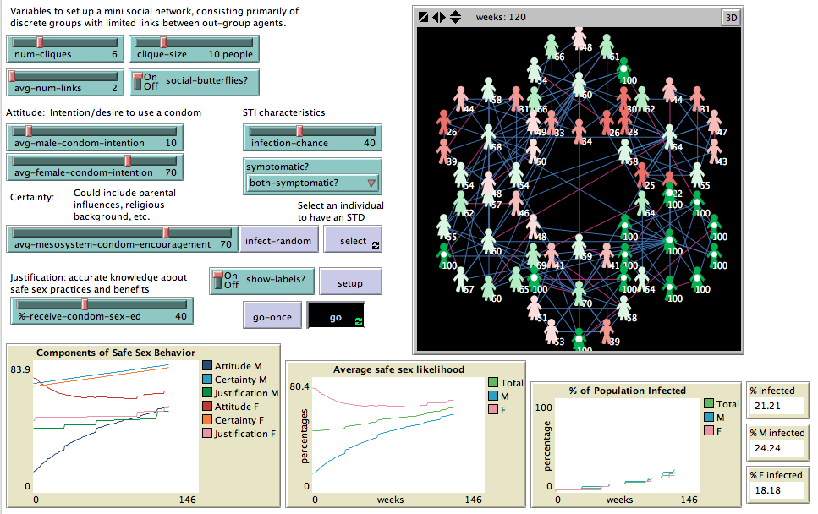
Sample Outcomes
Members of the same social group influence one another’s attitudes

Slide 6
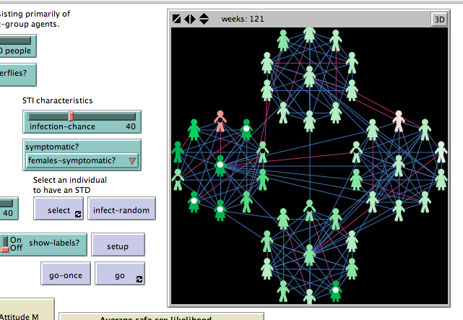
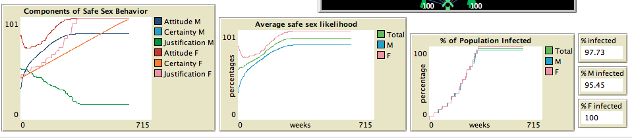
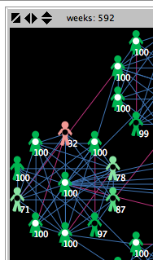
Still has a negative attitude towards wearing a condom, because he doesn’t realize he is infected
Once an agent realizes they have an STI, they form a strong desire for safe sex
Dot color indicates whether the agent knows they have an STI (based on being symptomatic)
Notes:
Its time to write about the turtles, not watch the turtles

Slide 7
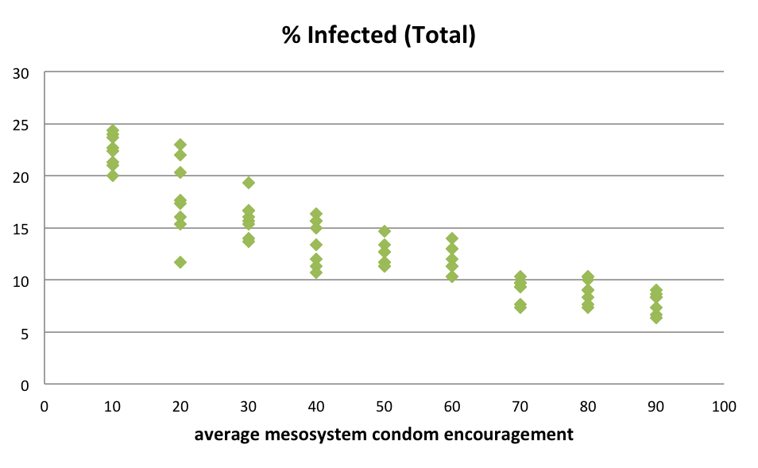
Analysis & Sample Trials
Model indicates potential for reducing infection by increasing Certainty variable (family upbringing, good values important)

