Slide 1
Safe Sex Attitudes and Behaviors
lizz bartos
Guiding questions:
  What factors seem to be most influential in determining whether or not an individual will contract an STI?
  What factors influence the spread of attitudes towards safe sex?
  Are the two above questions interdependent? What implications could this have for targeting information campaigns to this demographic (college-aged Americans)?
Attitudes and behaviors can be influenced by social interactions, past events (of others and self), knowledge of safe sex practices and benefits
Notes:
The Poster Slam is a presentation that you can think of as a brief “ad” or “promo” for your poster. The purpose of your presentation is to convince others in the class to check out your work during the poster session (which will occur the week after). You may be as theatrical/dramatic as you like :-)

Slide 2
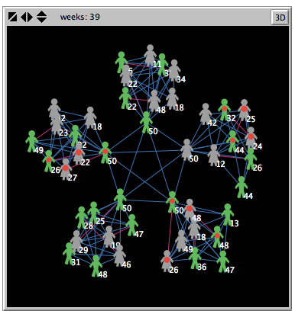
Agents are in social networks, forming and breaking friendship and sexual relationship links
Agent have different levels of tendencies to share information with others and tendencies to practice safe sex with others, which also may evolve

