Slide 1
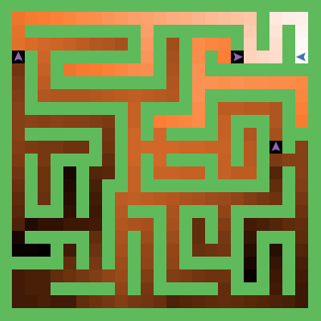
Collaborative Diffusion: Game AI for Kids
Natalie Murray

Slide 2
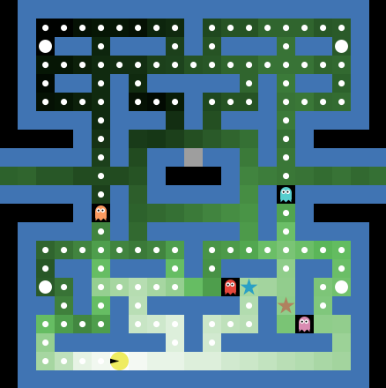
Collaborative Diffusion!
Simple but powerful method for multiple agents to work together in pursuit of a target
Great way to get kids interested in computer science
Clear enough to teach middle school children about AI

Slide 3
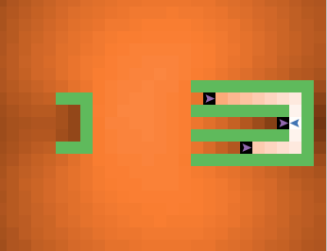
Collaborative Diffusion!
Basic Idea:
  Goal emits scent
  Agents follow scent
  Agents dampen scent where they are, thus encouraging collaboration
Simple rules, nice emergent behavior!

