Slide 1
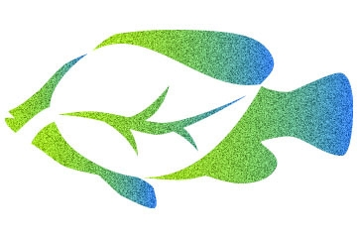
Aquaponics
EECS 472 – Designing and Constructing Models with Multi-Agent Languages
Prof.Uri Wilensky
AsmaaAlJuhani

Slide 2
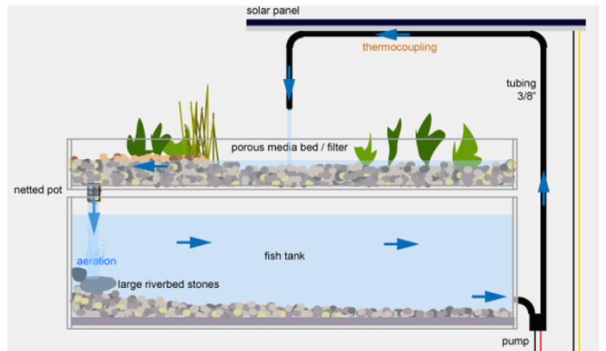
What is Aquaponics?
Aquaponics consist of two main parts : Aquaculture (fish farming) and Hydroponics (soil-less growing of plants).
Aquaponics can provide fresh food in the form of both protein and vegetables, that is free of pesticides and herbicides.

Slide 3
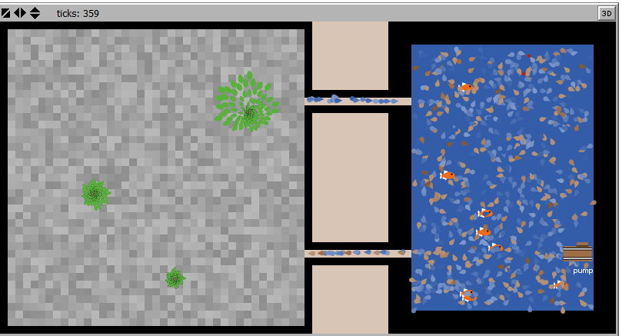
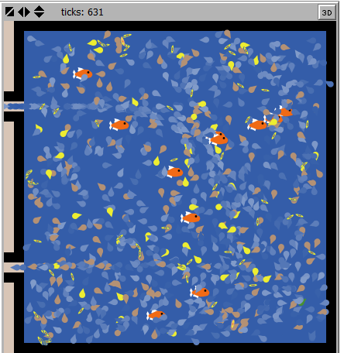
Virtual Aquaponics
Educational Agent-Based Model
Aquaponics gives a clear vision of the system mechanism.
Allow user to tune different factors and see the result.
What will happen if:
Overfeed fish ?
Don’t have enough plants?
a fish die?
No Bacteria?

