Slide 1
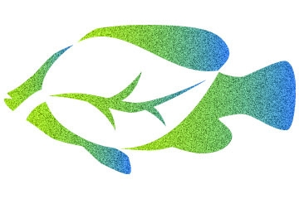
Aquaponics

Slide 2
Outline
What is the Aquaponics?
The components of the Aquaponics
How it works
The importance of the Aquaponics

Slide 3
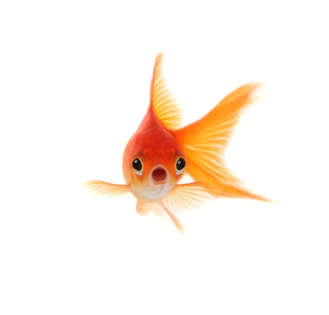
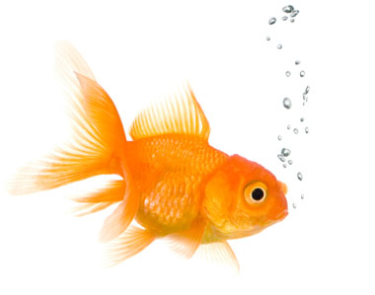
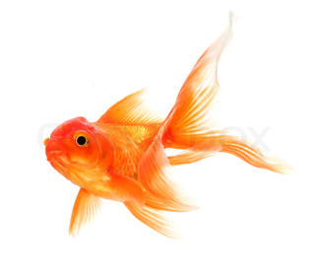
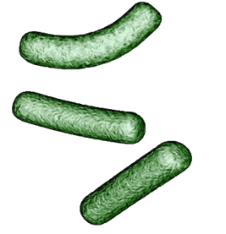
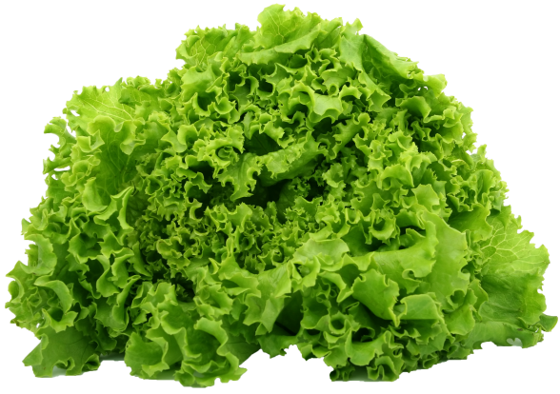
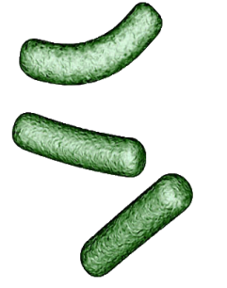
What is the Aquaponics?
Aquaponics is a food production system that combines conventional aquaculture, (raising aquatic animals such as fish), with hydroponics (cultivating plants in water) in a symbiotic environment.
The fish waste provides a food source for the plants and the plants provide a natural filter for the water the fish live in. Aquaponics produces safe, fresh, organic fish and vegetables.
Fish produce waste
Plants filter water that returns to the fish
Bacteria convert waste to fertilizer for plants

Slide 4
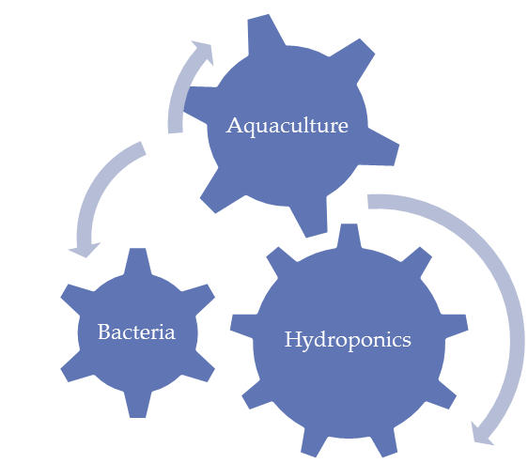
The components
Aquaponics consists of two main parts and one additional , the aquaculture part for raising aquatic animals, the hydroponics part for growing plants and the Bacteria part for conversion of ammonia into nitrates.

Slide 5
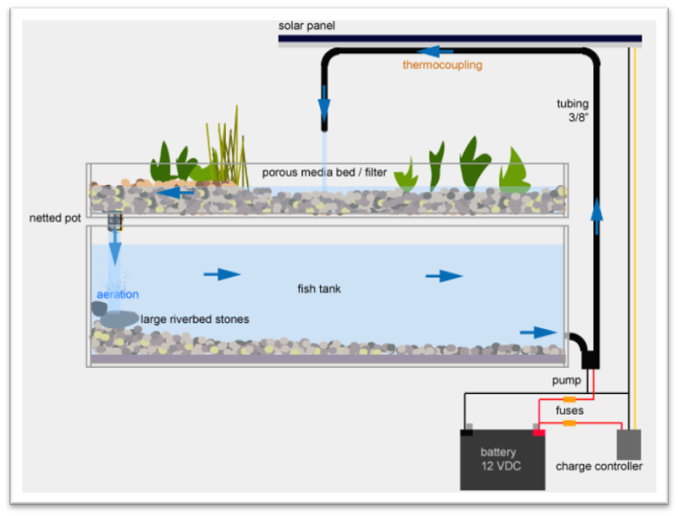
How the system works
fish produce ammonia
bacteria break the ammonia down to nitrates
plants feed on the nitrates to create fish food to start the cycle all over again.

Slide 6
Aquaponics Description

Slide 7
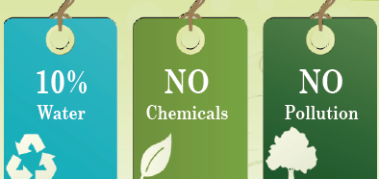
The importance of the Aquaponics
It help to reduce the labour
Higher production rate
Provides income from two separate products
Aquacultural waste products are used

