Slide 1



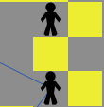



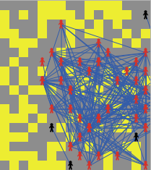
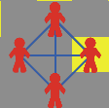
Fred and Joe Fight the Zombies: A Study in Human Survivability
But the real secret to surviving the zombie apocalypse is storing enough energy to make awesome clones of yourself.
Hi I’m Fred
And I’m Joe
We’re best friends…
Trying to survive the Zombie Apocalypse
Good luck.
Survival Tips
Clustering
Clustering only helps when the human population starts off as greater than the zombie population. If the Zombie population outnumbers the human population in the beginning of the simulation, clustering hinders survivability.
When near a zombie…
Move away. Fast.
However, if you can’t avoid them…
Reproduction
When humans were reproducing/ cloning and inheriting the traits of their parent figure, the zombie population decreased more rapidly than when there was no reproduction occurring.
And you happen to have a lot of friends….
They’ll come help you fight them off.

