Slide 1




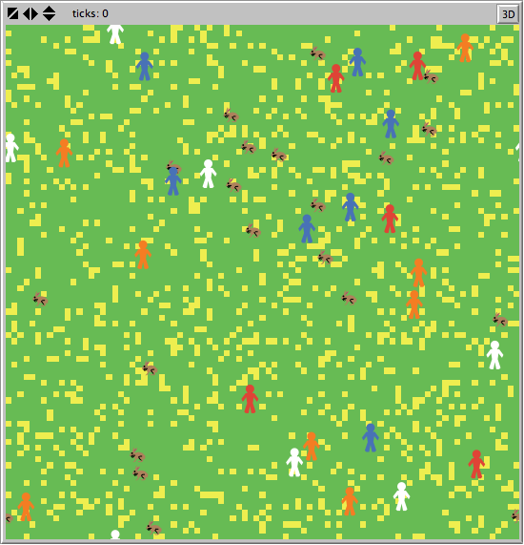

The Hunger Games
Paleolithic Hunter-Gatherer Survival Simulations
Tribe 1
Tribe 2
The Rules:
Hunter (Red/Blue): I look for rabbits to eat. If there aren’t any more rabbits and I’m hungry, I’ll attack someone from the other tribe!
Gatherer (White/Orange): I look for plants to collect and eat. I hope we don’t run out of rabbits…
What was the best way to maximize the tribe’s survival? More hunters to take out the other tribe, or more gatherers to quickly harvest food? The history books can’t say, but this model might have a thing or two to teach us…
Goal: To survive as long as possible given the edible flora and fauna available.
Who did it best?
No actual rabbits were harmed in the testing of this model.

