Slide 1
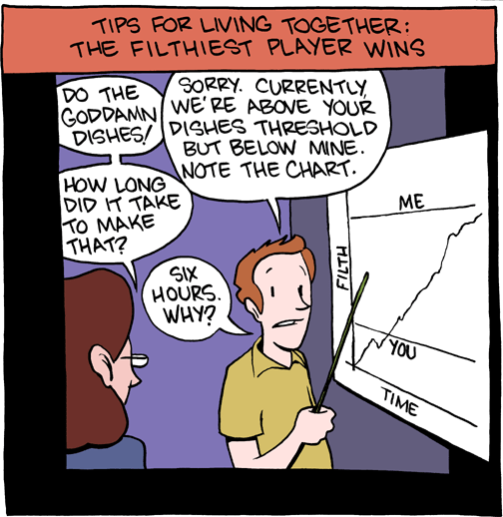
"May the odds be ever in your favor" :
An N-person customizable Game Theory Model, built to explore the power and effects of different decision making processes.
By: Peter Jourgensen

Slide 2
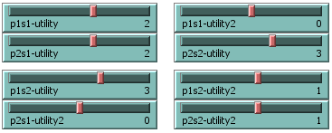
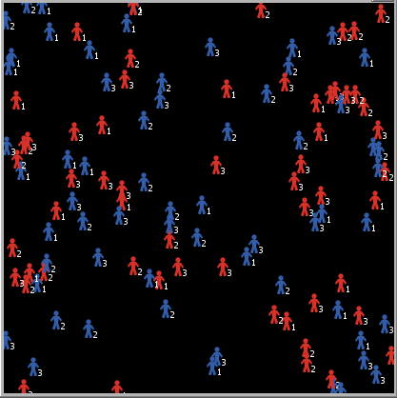
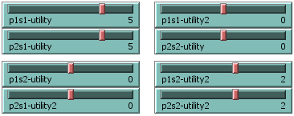
What is it??
(Prisoner's Dilemma)
(Coordination Game)
...AND MORE TO COME!!

Slide 3
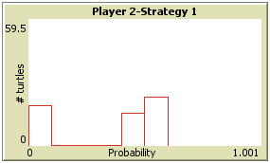
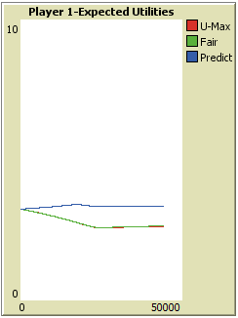
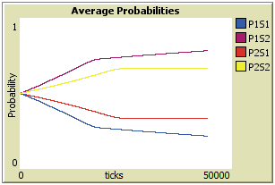
What does it do??

