Slide 1
How Do Organizations Change?
Eleanor Anderson, EECS 472

Slide 2
Leaders mandate something new . . .
. . .But what really happens on the ground?
ACGME reduces working hours for residents
Implementation requires working against the hospital hierarchy
Some hospitals make a meaningful change; others don’t.
Why?
A car company introduces new software for its crash analysts
The software has great features
But many analysts conclude it’s useless and discard it
Why?
Notes:
Accreditation Coun- cil for Graduate Medical Education

Slide 3
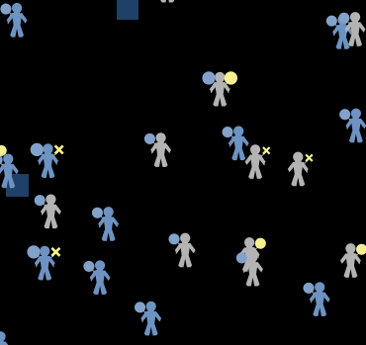
Agent-based models can help!
Created ABM based on real cases described in ethnographic work
Can the mechanisms these researchers describe account for the phenomena they observe?
What might happen in other areas of the parameter space?
Come find out!

