Slide 1
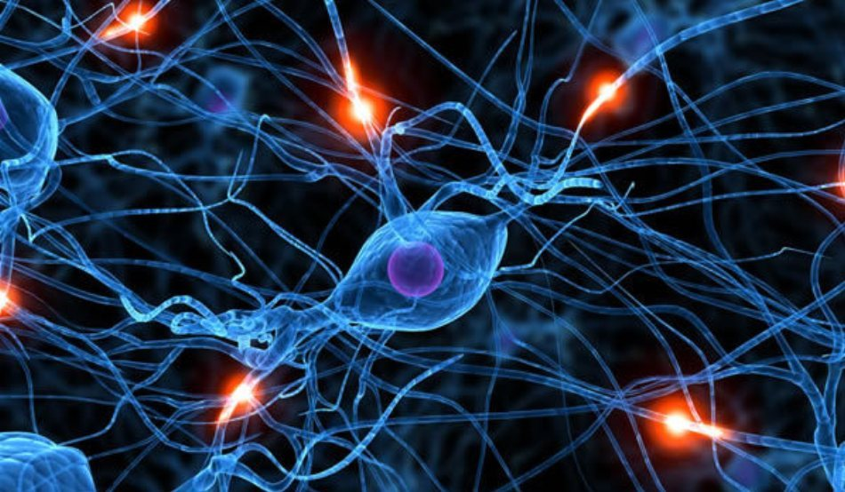
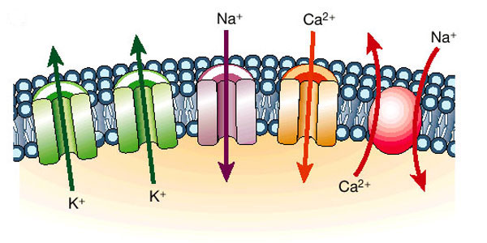
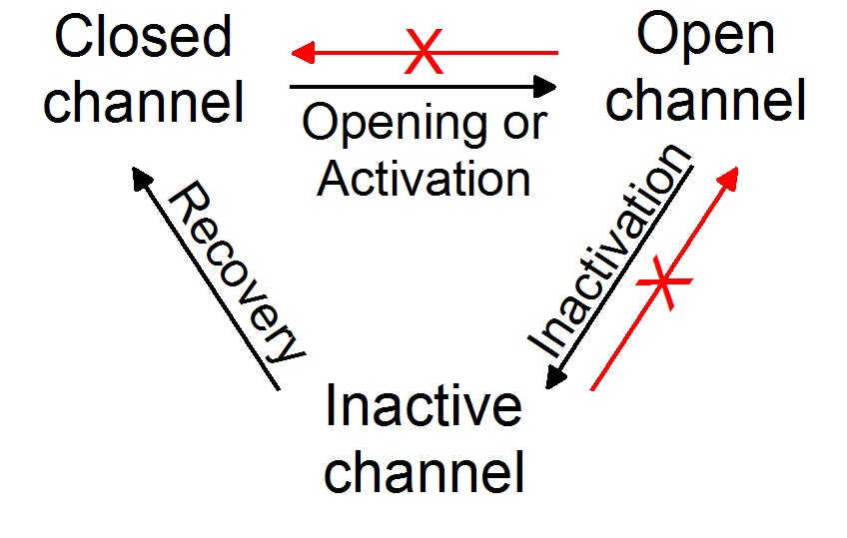
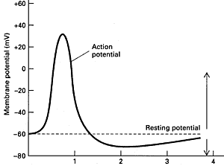
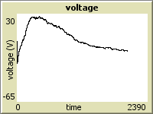
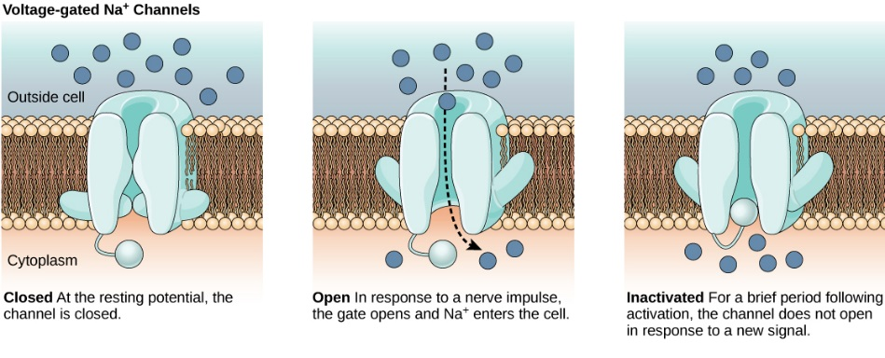

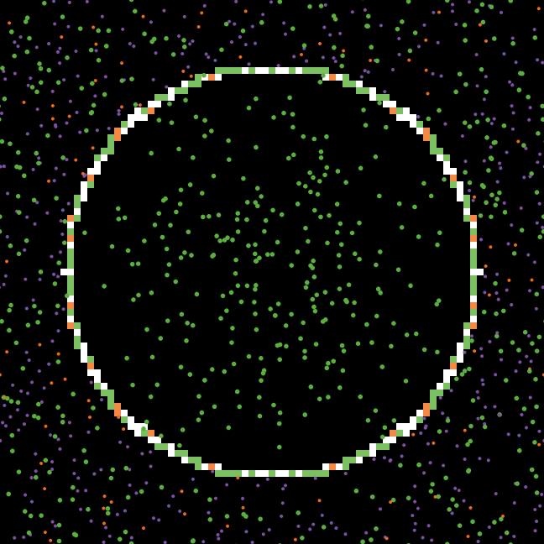
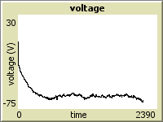
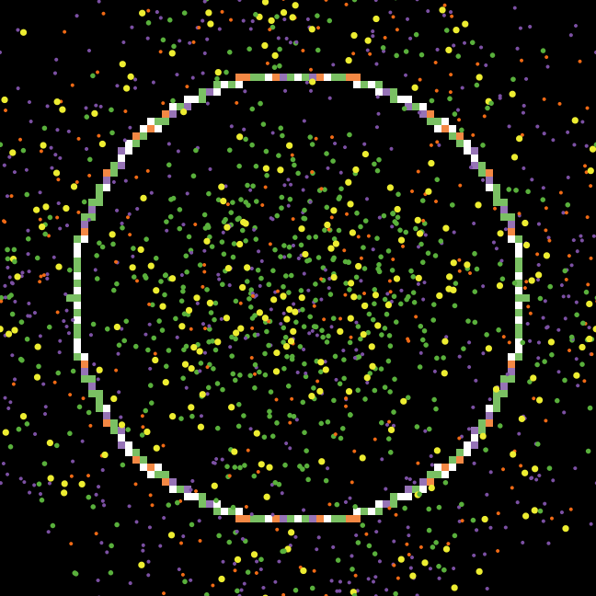
Neuron Model
Brendan Frick | Professor Uri Wilensky| EECS 372
Modelling Goal
Channel Selectivity
Channel States
Results
To model a neuron at the ionic level
1.
2.
Neuron Properties
Neuron Properties
K⁺, Na⁺, Ca⁺⁺, and Cl⁻ ions
Impassable cell membrane
Selective, voltage gated transmembrane channel proteins
Electrophysiological response
Voltage Gating
Membrane Potential
Action Potential 4.
Modelled current clamp Action Potential
3.
NetLogo Properties
Turtles - Ions
Patches – Cell Membrane
Neuron Model
  Turtles own
      Classifier (type of ion)
      Charge (-1, 0, +1, +2)
      Ionic Radius
      Location – intra/extracellular
  Turtles do
      Interact with ions
      Interact with channels
      Move randomly
  Patches own
      Opening criteria
      Selectivity to classifiers
      Impassability
  Patches do
      Attract ions
      Push ions through membrane
      Switch location variable of turtles
Equilibrium Cell
Modelled current clamp tail current
Conclusion
It is possible to model a functional neuron using ABM.
Equilibrium concentration is feasible; equilibrium kinetics are harder to achieve
Equilibrium effects can be achieved by micromanaging ion concentrations and channel densities
Next steps will be retooling channel state dynamics with Markov chains, introducing more voltage gated and ligand gated channels, and adding in repolarization features
Modelled current clamp response
Model Parameters
To model different cell environments
Membrane Channel Density
To model different cell characteristics
Inactivation Determination
To model methods for channel inactivation
Ion Concentrations
Slider values for each type of ion
Affects concentration gradient
Slider probabilities for each channel type
Affects membrane conductance
Internal parameter because of complexity
Affects ion flow kinetics
Works Cited
Marbán, E. Cardiac channelopathies. Nature 415, 213-218 (2002).
“Neuronal Action Potential.” PhysiologyWeb. N.p., n.d. Web. 07 June 2015.
Eva Horne et al., Principles of Biology. OpenStaxCNX. 07 Junes, 2015. http://cnx.org/contents/db89c8f8-a27c-468-ad2a-19d11a2a7e2e@21.1.
“Addiction.” NIH Office of Science Education N.p., n.d. Web 07 June 2015.

