Slide 1
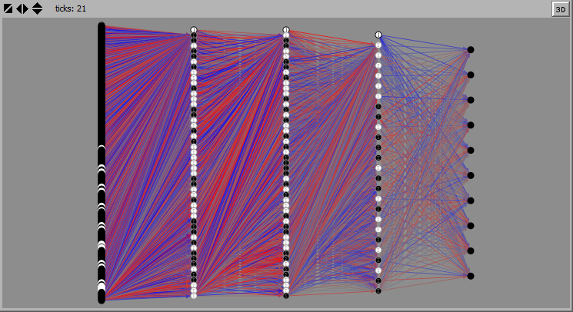
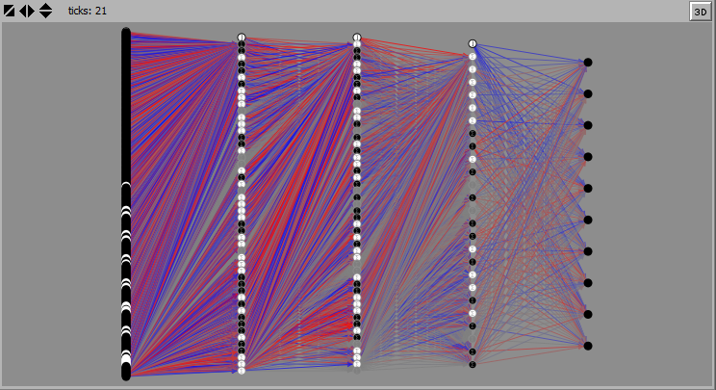
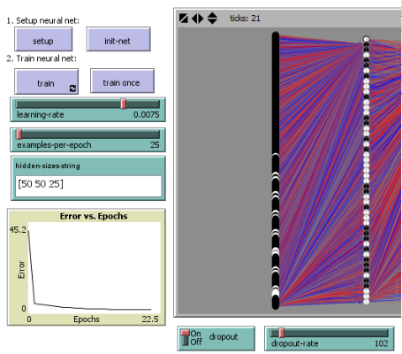
Deep Neural Networks: Visualization and Dropout
What does dropout training look like?
Visualize deep neural networks
Compare network topologies between dropout and normal networks
Generalize network architecture for deep theoretical intuitions
Dropout Learning
Randomly remove nodes from training
Empirically effective, used in industry
Weak Theoretical Explanations
Design
Users control all aspects of network, including architecture
Visualization of connection strength, neuron activation
Results?
Inconclusive
Could not find dropout-favoring network in time allotted
Though speed was better
Future Work
Applications to research
Model enhancements
Better parameters
Jacob Samson

