Slide 1

The PMM
A Simple Complete Conservative Sustainable Agent-Based Model Economy
Some Hypotheses
Using ModEco Software V2.03α
URL: modeco-software.webs.com/mabs-2013
Email: orrery@rogers.com
In affiliation with:
Multi-Agent Based Simulations
7th May, 2013
By: Garvin H Boyle
Notes:
Good afternoon. My name is Garvin Boyle. I would like to talk to you today about a simple model economy, the adjustments that needed to be made to make it sustainable, and a set of six falsifiable hypotheses that come out of this study.

Slide 2
Agenda
Project Origins
Model (The PMM) Characteristics
Six Falsifiable Hypotheses

Slide 3
ModEco - Goals
A1
Selected as a topic of interest by my group of gifted high-school students (Oct 2010)
“What does it mean, to have a sustainable economy?”
To construct a simple sustainable economy
To explore the necessary and sufficient conditions of sustainability
Notes:
This project had its origins in 2010 when a group of gifted high-school students urged me to take on an economic project as part of an after school program of studies. They expressed concern over the sustainability of modern economies, and want to understand the issues better. So, we set about to build a model and identify the necessary and sufficient conditions for an economy to be sustainable.

Slide 4
Project Methodology
A
A2
Step 1 – Build a very simple but complete model in which
  (A) Biophysical – agents need to grow food, harvest it, and eat it to live, and in which
  (B) Economic – cash enables the exchange of goods and services.
Step 2 – Adjust parameters and add features until it is sustainable.
Step 3 – Analyse it to determine the necessary and sufficient conditions for sustainability.
Estimated time to complete it: Six months.
Notes:
We had a three-step approach – you might say we were following a spiral software development methodology, in part. Our plan was to build a simple model that had both a biophysical subsystem at its base, and a financial subsystem riding on top of that. Then, we would adjust it, adding features as needed, until it was deemed “sustainable”. Having achieved sustainability, then we would analyze it graphically and mathematically to understand how it works.

Slide 5
The PMM
C3
Sustainability has proven extremely difficult to demonstrate.
The only sustainable economy achieved to date in the ModEco project is a highly restrictive model styled as the “Perpetual Motion Machine”, or PMM.
Notes:
Unfortunately for our project, we found sustainability proved to be a very elusive characteristic. After much effort and serious discussion, the only sustainable version of our economy that we could produce had some aspects that brought us face-to-face with some difficult issues. The results were a system we called “The PMM”, the perpetual motion machine. Now, many of you will say “But, a perpetual motion machine is not possible!” Well. That’s seems to be the stark reality. Our conclusion was that a combined biophysical and economic model could not be made sustainable.
That is our major hypothesis. We do not believe that anyone can make a sustainable economic model within our design goals. And we have addressed that idea as six falsifiable hypotheses.
But, I get ahead of myself. Let’s look as the model.

Slide 6
A New Paradigm – Restorative*
C1
A truly sustainable economy is at least conservative, and at best, restorative, when needed.
All extracts from the environment are returned to the environment for later reuse.
Energy consumption equals energy inputs.
“The demands placed on the environment do not reduce its capacity to support future generations to the same degree.”
*The Ecology of Commerce, Paul Hawken, 1993
Notes:
The first issue we had to address was this: what, exactly, do people mean by “sustainable”. The best guidance we could find was drawn from a small book by Paul Hawken written in 1993. We have them written here as three guiding concepts, and a general statement of normative goals.

Slide 7
Two Visions of the Future
C2
1st
2nd
Extractive economy
Consumption-based:
  Depleted non-renewables
  Over-taxed renewables
Leads to:
  Food and water shortages
  Wide-spread famine
  Economic collapse
  Global resource wars
Return of the Dark Ages
Sustained misery
Conservative of non-renewables
Restorative of renewables
Global population stabilized
Sustained prosperity
Nature will impose sustainability upon the human race.
Misery or prosperity?
It depends on our choices in the next few years.
Notes:
But, with some thought we came to the conclusion that “sustainability” is a relatively primitive goal. Humanity might continue on as it is doing right now and be sustainable, but it would be sustained misery for the bulk of us. What my young students were really interested in was sustained prosperity of some sort - a sustainment of a modern high-tech society, and not a sustainment of a hunter-gatherer society buttressed by some subsistence farming.

Slide 8
Oft’ Mentioned Concepts
Re The Ills of Modern Society
The
Wealth
Gap
Price
Controls
Steady-State
Economics
Waste
management
Social
Justice
Unemployment
Quotas
Carrying
Capacity
Deficit
Financing
Free-market
Capitalism
Energy
& Entropy
Financial
Crises
Welfare
grants
Inflation
Deflation
Smaller Government
Notes:
Our discussions of sustainability lead to some research, and a lot of opinions about the “Ills of a modern society”. For example, there is a lot of talk of free-market capitalism, the wealth gap, and social justice. We found there was substantially less talk about waste management, energy budgets, or carrying capacities.

Slide 9
About Sustainable Economies
hpC1
Modern economic experts talk about “sustainable growth” as they worry about the conflicting demands of a lagging economy and increasing damage to the environment.
When talking about helping the third world economies, they talk about “sustainable development” as they worry about adding the weight of another extraction and consumption based economy when our environment can hardly support the weight as it is.
Notes:
We found there was an interesting difference in perspective. When talking about the economies of the developed world, most global experts put an emphasis on the all-important sustainable growth of our economy, while worrying about the ecological impacts. When talking about the developing world, the emphasis was changed slightly to sustainable development. The clear implication is that we, in the industrialized world, need to have sustainable development in the other half of the world to support our own sustainable growth.

Slide 10
Common But Faulty Concepts
hpC2
“Sustainable growth”
  Growth is sustainable only if there are no limits on energy or resources, and no limits on pollution
  The Earth’s non-renewable energy resources such as coal and oil are being rapidly depleted
  The Earth’s ability to absorb waste has been exhausted
  Nice words only. “Sustainable growth” cannot exist.
“De-link consumption and economic growth”
  The GDP can continue to rise even as consumption of resources levels off. This happens as the economy becomes more service oriented.
  Enticing myth. Delinking is not possible.
Notes:
We decided to deconstruct a few of the concepts that were commonly expressed, but seemed to us to be faulty:
Sustainable growth was clearly a silly idea for any long-term vision.
Some argue that “growth” can happen in many ways, and cultural growth can happen apart from growth in consumption, allowing the GDP to continue to grow.
Both of these seemed to us to be comforting myths that did not really make sense.

Slide 11
Common But Faulty Concepts
hpC3
Sustainable development
  Development must mean some advancement in the efficiency of a pre-existing industry or economy.
  Development is a kind of growth.
  Sustainable development cannot exist.
  You cannot have your cake, and eat it too?
Notes:
Here is the third idea we thought appeared to be faulty:
Sustainable development seemed equally as silly, but it had widespread support as an idea. It merely changed “growth” into “development”, as if development did not imply growth.
But, what these discussions tell us is that people are worried, and are trying to convince themselves that “Everything is really OK, and we don’t have to worry. We will find a way to make this all work, and we get to have our cake and eat it at the same time.”

Slide 12
Agenda
Project Origins
Model (The PMM) Characteristics
Six Falsifiable Hypotheses

Slide 13
Our Main Hypothesis
The features exhibited by the PMM are all both necessary and sufficient to demonstrate sustainability in a combined biophysical and economic model.

Slide 14
C12
Definition: Conforming Model Economy
A conforming model economy is:
Simple – one commodity, cash only, least set of controls.
Complete – biophysical/economic (vertically) and birth-to-death (horizontally), but not across species (by depth).
Conservative – four quantities conserved (mass, energy, cash, intrinsic value) at transaction and system levels.
Sustainable – still vibrant after one million ticks without biophysical system collapse or economic system dysfunction.
Agent based – computer model in which agents compete for food, eat, and reproduce or die.
A model by analogy – a demonstrative model, rather than a predictive model, providing insight by analogy.
THE PMM IS CONSIDERED A CONFORMING MODEL ECONOMY
For these hypotheses (Until shown to be otherwise)

Slide 15
Our ModEco vision –
Simple complete conservative sustainable agent-based model
hpC4
“Simple” in the sense that:
it models the production and consumption of a single commodity – food.
it functions just above a barter level of exchange, in which cash is used to enable ALL exchanges of goods and services.
it contains the least set of economic functions necessary to demonstrate a sustainable economy.

Slide 16
C4
The PMM
Simple complete conservative sustainable agent-base model
Economic
Controls
The PMM
BIGGER SET
LEAST SET
Economically Simple:
single commodity
cash - just above barter level
least set of economic controls
CASH
NOTES
TOOLS
FOOD
CLOTHES
BARTER
Financial
Instruments
Commodities

Slide 17
Our ModEco vision –
Simple complete conservative sustainable agent-based model
hpC5
“Complete” in the sense that :
Vertical completeness:
  the underlying biophysical subsystem demonstrates key life functions such as working, eating, reproducing, aging, dying due to old age or hunger; agents compete for scarce resources; successful agents live to reproduce; unsuccessful agents die without offspring.
  the overlayed economic subsystem ensures that every exchange of biophysical goods and services is reciprocated with an exchange of cash.
Horizontal completeness: conserved quantities are tracked in a complete cycle (forming a closed system).

Slide 18
The PMM
Simple complete conservative sustainable agent-based model
C5
HORIZONTAL
Dynamically Complete:
Vertical: both biophysical AND economic subsystems
Horizontal: seed to food to waste, and back; birth to death
CASH FLOWS AND STORES IN AN ECONOMY
ECONOMIC
SUBSYSTEM
VERTICAL
BIOPHYSICAL
SUBSYSTEM
MASS/ENERGY FLOWS AND STORES IN A PERISHABLE ECOSYSTEM
Other species

Slide 19
hpC6
Our ModEco vision –
Simple complete conservative sustainable agent-based model
“Conservative” in the sense that:
key biophysical and economic quantities such as mass, energy, cash and intrinsic metabolic value are conserved in all activities.
intrinsic value is determined by metabolic needs; an agent needs to consume a predetermined amount of food (combined mass/energy) per tick to stay alive; and it must expend energy to work to earn money to buy food; so the food is “valued” in terms of biophysical metabolic needs.

Slide 20
C6
The PMM
Simple complete conservative sustainable agent-based model
Conservative of key quantities:
At a low level: mass, energy, cash and intrinsic value are conserved in all agent-to-agent transactions.
At a high level: the system is closed for all conserved quantities.
CASH
INTRINSIC
VALUE
MASS
ENERGY

Slide 21
The Mass Cycle
hpC6a
GRANTS
Estate Mgr
Materiel
Mgr
Eu
SELL WASTE
Mu
Mu
Wrkr As Consumer
Mu
CONSUME
BUY RECYCLED
Mu
Eu
HIRE Wrkr
BUY SUPPLIES
DEATHS
Frmr As Producer
Mu
Mu
Frmr As Consumer
Eu
Mu
CONSUME
Mu
Eu

Slide 22
The Energy Cycle
hpC6b
Estate Mgr
Materiel
Mgr
Mu
Eu
Wrkr As Consumer
Mu
CONSUME
Eu
MANU-FACTURE
Eu
DEATHS
GRANTS
Frmr As Producer
BUY SUPPLIES
Mu
Frmr As Consumer
Eu
Mu
CONSUME
Eu
Eu

Slide 23
The Cash Cycle
hpC6c
DEATHS
Estate Mgr
Materiel Mgr
BUY RECYCLED
BUY WASTE
HIRE WORKERS
Wrkr
Frmr As
Producer
GRANTS
BUY SUPPLIES
Frmr As
Consumer

Slide 24
C10
The PMM
Simple complete conservative sustainable agent-based model
Life goes on
for 1M+ ticks!
√
X
All agents dead!

Slide 25
hpC7
Our ModEco vision –
Simple complete conservative sustainable agent-based model
“Model” in the sense that :
An abstract logical economy, rather than a simulation of any real-world economy.
ModEco demonstrates abstracted logical economies.
ModEco enables students to:
  Design a logical economy via start-up parameters;
  Monitor real-time economic developments on-screen; and
  Collect economic data for later analysis.
ModEco does not simulate any ‘real-world’ economy.

Slide 26
C11
The PMM
Simple complete conservative sustainable agent-based model
SIMULATION vs DEMONSTRATION
LIFE CYCLE:
Design
Implementation vs
Verification
Validation
Analysis
LIFE CYCLE:
Design
Implementation
Verification
Validation
Analysis
Weather Model vs Model home
Prediction vs Analogy

Slide 27
D1A
ModEco – Features Added to Baseline System to Achieve Sustainability
#01 – Process quotas – To prevent one wealthy agent from buying and entire store in one turn;
#02 – Welfare grants – To gift the assets of dying agents back into the economy;
#03 – Business factors – To allow agents to diversify assets within personal stores;
#04 – Waste management – To distribute waste from city center to outskirts;
#05 – Deficit financing – To provide cash float during unstable initial transient period prior to steady-state;
#06 – Price controls – To eliminate “friction” and so create a “Class 3 Perpetual Motion Machine”, or PMM.

Slide 28
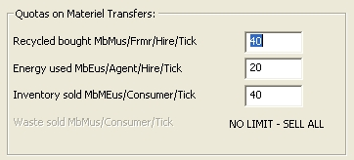
ModEco Features – Added Features
# 01 – Process Quotas
hpD1
A ‘Process Quota’ is an upper limit on the number of units of materiel that can change hands in one transaction.
Process quota’s prevent one agent from buying up all of a resource, or satiating all of the demand.

Slide 29
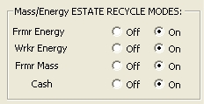
ModEco Features – Added Features
# 02 – EMgr and Municipal Grants
hpD2
When an agent dies, its assets are transferred to the Estate Manager (EMgr), including cash, energy and mass.
POOR BUT DESERVING – Agents that have a business transaction in progress, but have insufficient resources to meet quota, apply for a grant, and, if available, are given resources.

Slide 30
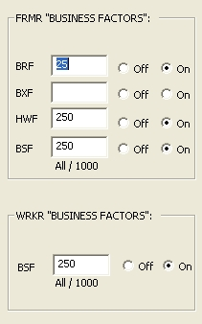
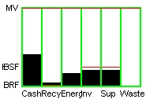
ModEco Features – Added Features
# 03 – Business Factors
hpD3
Agents must ensure that their net worth is spread across their asset classes.
Agents enter into transactions only if the value of the affected asset class is below a threshold percentage.
Inventory
Cash
Supplies
Energy
Waste Mass
Recycled Mass
Cash Rec Nrg Inv Sup Was

Slide 31

ModEco Features – Added Features
# 04 – Waste Management
hpD4
Waste mass tends to concentrate in the center of villages, causing them to weaken.
An immortal central Materiel Manager (MMgr) buys All waste mass and sells it to all Frmrs, thereby redistributing the mass.
MMgr

Slide 32

ModEco Features – Added Features
#05 – Central Deficit Spending
hpD5
Prior to steady-state, it is difficult to know how much cash is needed to make the economy robust.
The MMgr has the ability to purchase (toxic) waste – even when he has no cash – thereby injecting cash into the economy.

Slide 33
ModEco Features – Added Features
# 06 – Price Controls
D6
To achieve sustainability:
The PMM is like a an idealized bicycle wheel
Remove the friction that saps out the energy, and it will run forever.
This clearly is not what we imagine a real-world sustainable economy to be like, BUT
IT IS THE ONLY SUSTAINABLE ECONOMY ACHIEVED SO FAR.

Slide 34
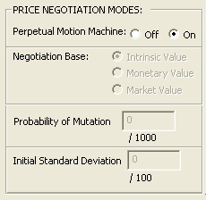
ModEco Features – Added Features
# 06 – Price Controls
D7
To achieve sustainability:
No negotiations – all price negotiation mechanisms must be turned off, and
No Price/value gap – all prices must be fixed at the intrinsic metabolic value.

Slide 35
The Role of Hypotheses
E1
Understanding comes from falsifiable hypotheses:
You cannot prove any hypothesis to be true;
You can only prove an hypothesis to be false;
There are, therefore, no “scientific facts”;
There are only scientific hypotheses that have withstood all attempts, so far, to disprove them.
A good hypothesis:
Is a prediction – it is a clear statement of expected outcomes for a class of potential experiments to be done in the future;
Is falsifiable – there must be experimental means by which the truth of the hypothesis can be tested; this means progress and understanding comes largely from falsified hypotheses;
Is as general as possible – and so it may be validated in some experiments, and falsified in others, leading to better more specific hypotheses.

Slide 36
Some Hypotheses
E1a
#01 – Necessity and Sufficiency Hypothesis – The PMM as found in ModEco is the most simple conforming model economy that can be constructed.
#02 – Price/Value Gap Hypothesis – It is not possible to construct a conforming model economy in which all negotiated transactions allow for the possibility of profit and loss.
#03 – Intrinsic Value Hypothesis – All conforming model economies are such that the biophysical needs of the agents either implicitly or explicitly control the price of food.
#04 – Central Authority Hypothesis – Any conforming model economy must include immortal non-local agents performing the roles of the MMgr and EMgr.
#05 – Social Justice Hypothesis – In any conforming model economy, the majority of agents are poor.
#06 – MEP and MEPP Hypothesis – Conforming model economies do not exhibit the MEP or MEPP.

Slide 37
Some Hypotheses
#01 – Necessity and Sufficiency Hypothesis
E2
Is long-term sustainability truly an “economic” possibility?
Under what circumstances?
What are the necessary and sufficient conditions, from the point of view of dynamic systems?

Slide 38
Some Hypotheses
#01 – Necessity and Sufficiency Hypothesis
E3
The PMM as found in ModEco is the most simple conforming model economy that can be constructed.
Goal: To focus attention on the questions of necessity and sufficiency of the various features of simple sustainable economies.
It is expected that this hypothesis will be easy to falsify, but instructive in the disproving.
Is long-term sustainability truly an “economic” possibility?
Under what circumstances?

Slide 39
Some Hypotheses
#02 – Price/Value Gap Hypothesis
E4
It is not possible to construct a conforming model economy in which all negotiated transactions allow for the possibility of profit and loss.
Sustainability
VS
Free Market Economics
Are these ideals mutually exclusive?

Slide 40
Some Hypotheses
#03 – Intrinsic Value Hypothesis
E5
All conforming model economies are such that the biophysical needs of the agents either implicitly or explicitly control the price of food.
Price Influencers:
Contained energy
Embedded energy
Urgency
Rarity
Luxury
Critical Role of Energy in Setting Prices in a Sustainable Economy

Slide 41
Some Hypotheses
#04 – Central Authority Hypothesis
E6
Any conforming model economy must include immortal non-local agents performing the roles of the MMgr and EMgr.
Sustainability
VS
Small Central Government
Are these ideals mutually exclusive?

Slide 42

Some Hypotheses
#05 – Social Justice Hypothesis
E7
Frmrs:
No. VS wealth.
A small minority are very wealthy, having as much as 6 times the average wealth.
Most Frmrs are dirt poor, with the mode at $30,000.
By comparison, one Frmr garnered $250,000 in his lifetime. The rich get richer, the poor die young.

Slide 43
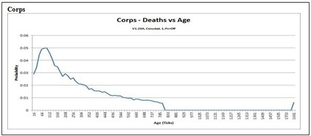

Some Hypotheses
#05 – Social Justice Hypothesis
E8
Frmrs:
Probability of death VS age.
Most children die of starvation while still young.
Many unhealthy Frmrs live on to 1600 ticks, when they die of old age.
Deaths peak between 60 and 112 ticks.
The healthy reproduce at 800 ticks.

Slide 44
Some Hypotheses
#05 – Social Justice Hypothesis
E9
In any conforming model economy, the majority of agents are poor.
Subsidiary hypothesis A: These poor agents live shorter lives than their wealthy colleagues.
Subsidiary hypothesis B: These poor agents experience energy throughput that is equal to or less than that of their more wealthy colleagues.
Sustainability
VS
Social Justice
Are these ideals mutually exclusive?

Slide 45
Some Hypotheses
#06.1 – MEP Hypothesis
E10
Maximum Entropy Principle (MEP)
The second law of thermodynamics states that the entropy of an isolated system never decreases, because isolated systems spontaneously evolve towards the state of maximum entropy.
Does an anaologous phenomenon exhibit itself in Agent-Based Models?

Slide 46
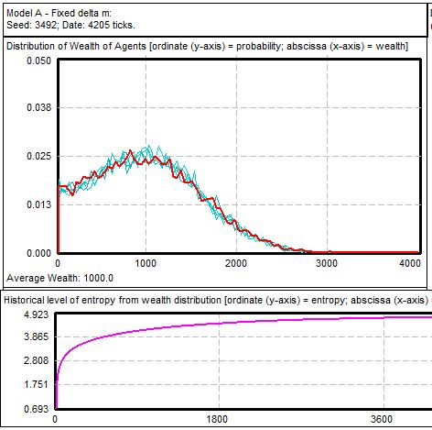
Some Hypotheses
#06.1 – MEP Hypothesis
E11
Agents:
Probability of wealth VS wealth.
One of Dr Yakovenko’s capital exchange models.
Entropic measure approaches a maximum.
Dragulescu and Yakovenko, 2000, “The Statistical Mechanics of Money”

Slide 47
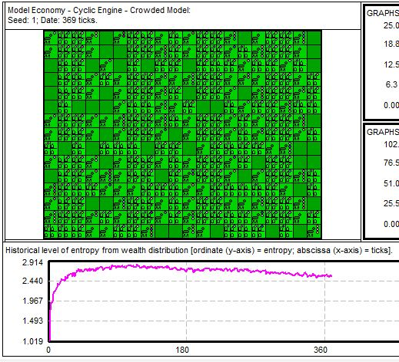
Some Hypotheses
#06.1 – MEP Hypothesis
E12
The PMM in ModEco:
Probability of wealth VS wealth (graph not shown).
An early PMM village before steady-state.
Entropic measure approaches a maximum,
then declines. ??!??

Slide 48
Some Hypotheses
#06.1 – MEP Hypothesis
E13
A closed conforming model economy initialized in a non-equilibrium state does not exhibit the MEP as it evolves through transient states towards its equilibrium state.
Does this phenomenon exhibit itself in ABMs?
Maximum Entropy Principle (MEP)

Slide 49
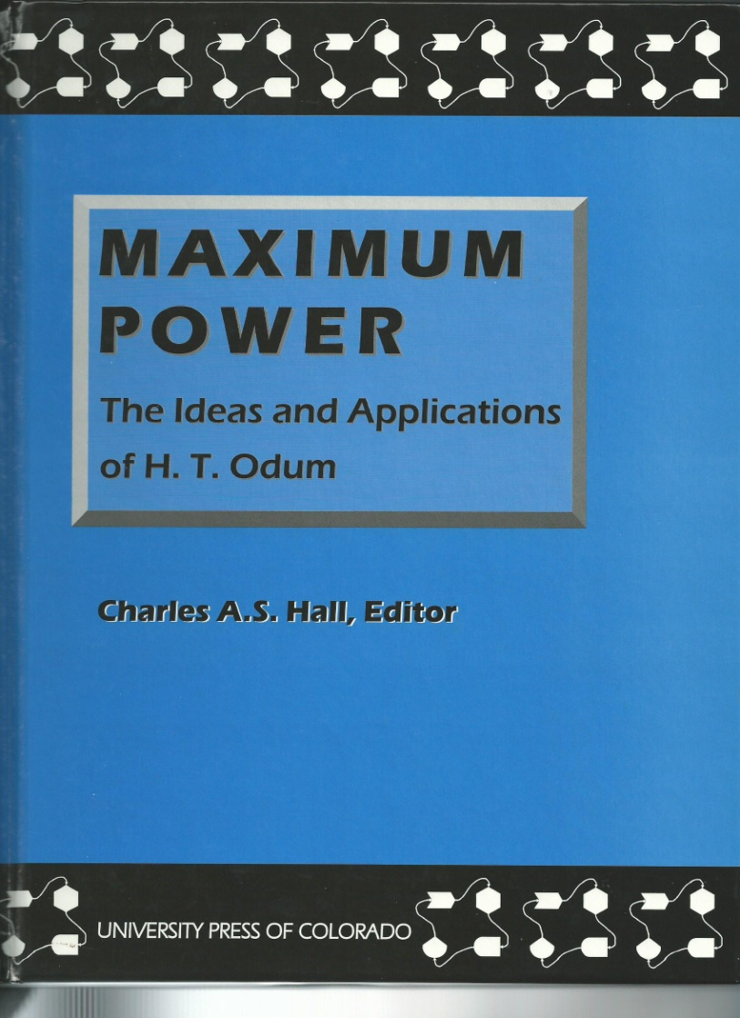
Some Hypotheses
#06.2 – MEPP Hypothesis
E14
The Maximum Entropy Production Principle (MEPP) implies that the rate of production of entropy in an open system never decreases, because open systems spontaneously evolve towards the state of maximum power.
MY PARAPHRASE!
Does this phenomenon exhibit itself in ABMs?

Slide 50
Some Hypotheses
#06.2 – MEPP Hypothesis
E15
An open conforming model economy initialized in a non-equilibrium state does not exhibit the MEPP as it evolves through transient states towards its stationary state far from equilibrium.
Maximum Entropy Production Principle (MEPP)
Does this phenomenon exhibit itself in ABMs?

Slide 51
The End
Questions?
F0

Slide 52
Six Hypotheses
E1a
#01 – Necessity and Sufficiency Hypothesis – The PMM as found in ModEco is the most simple conforming model economy that can be constructed.
#02 – Price/Value Gap Hypothesis – It is not possible to construct a conforming model economy in which all negotiated transactions allow for the possibility of profit and loss.
#03 – Intrinsic Value Hypothesis – All conforming model economies are such that the biophysical needs of the agents either implicitly or explicitly control the price of food.
#04 – Central Authority Hypothesis – Any conforming model economy must include immortal non-local agents performing the roles of the MMgr and EMgr.
#05 – Social Justice Hypothesis – In any conforming model economy, the majority of agents are poor.
#06 – MEP and MEPP Hypothesis – Conforming model economies do not exhibit the MEP or MEPP.
Questions?

Slide 53
Thank You For Coming!
F1

Slide 54
Hip Pocket Slides
G

Slide 55
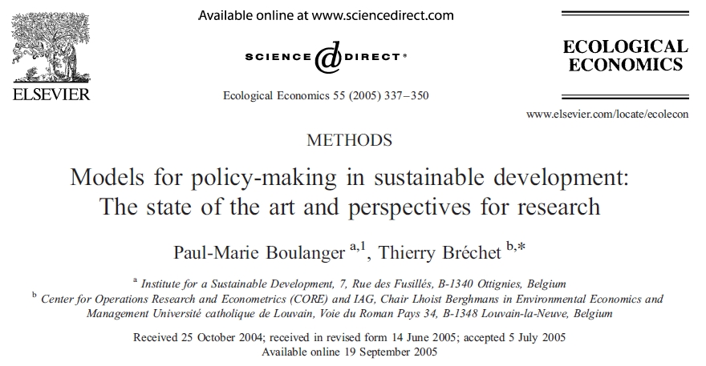

Slide 56


