Slide 1
The Use of Palmiter Genes in Evolutionary Economic Models
CoMSES 2019
October 7th – 25th, 2019
OpenABM
Garvin H Boyle, Orrery Software
Orrery-Software.webs.com
Orrery@Rogers.Com
https://www.comses.net/codebases/?query=boyle

Slide 2
Goals of This Presentation Are:
You understand the dynamics of evolution well enough to want to read more about it.
You understand the techniques of genetic coding, as devised by Dr Michael Palmiter, well enough to want to try them.
You get excited about the potential for evolutionary economic models.

Slide 3
Evolutionary Dynamics
Some Necessary Components
Reproduction with Variation:
  Agents must produce offspring from time to time.
  Operational traits must be passed from one generation of agent to the next.
  Traits are almost exactly replicated during reproduction, but with some error (some variation, some mutation).
Competition for Scarce Resources (energy and/or money):
  Agents must produce more offspring than have a reasonable chance of survival.
  So, there are not enough resources to keep all offspring operational.
Natural Selection of the Most Advantageous Traits:
  Selection for persistence is always a matter of many repetitions of randomized opportunities for small gains.
  Those offspring that are the most effective at gathering the scarce resources have a greater chance of survival.

Slide 4
Potential For Application of Evolutionary Dynamics
Systems that Evolve
Components that Evolve
Biological Systems
Social Systems
Economic Systems
Organisms, species, organs within organisms, energy transfer mechanisms, food webs, instinctive and learned habits, ecosystems within the biosphere, the biosphere itself.
Cultural norms of all kinds, legal systems, educational systems, health-care systems, technologies, the society itself.
Business models, supply chains, markets, money management principles, and even economic theories, and the economy itself.
ANY COMPLEX ADAPTIVE SYSTEM, AND ITS ADAPTIVE COMPONENTS

Slide 5
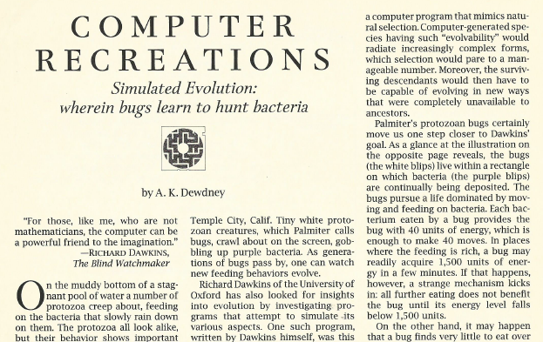
“Simulated Evolution”
By Dr Michael Palmiter

Slide 6
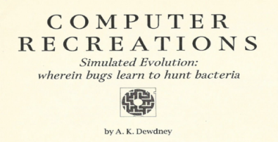
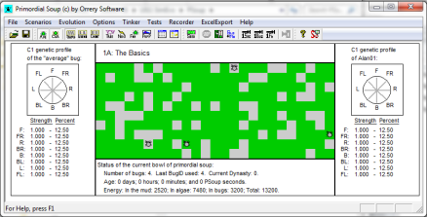
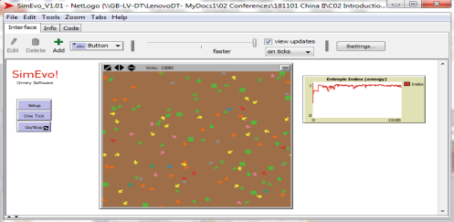
My Personal History
Studying Evolution Using ABMs
1985 – Dr Michael Palmiter – ‘Simulated Evolution’
1988 – IBM Business BASIC Language – ‘Evolve.BAS’
  My first demonstration of evolution with ABMs.
1989 – Article in ‘Scientific American’.
1989 – GW-BASIC Language – ‘Simulate.BAS’.
  My second demonstration.
1994 – Visual BASIC Language – ‘Pond.BAS’.
  My third demonstration.
2002 – C++ Language – ‘PSoup’.
  My fourth demonstration.
2018 – NetLogo Language – ‘SimEvo’.
  My fifth demonstration.

Slide 7
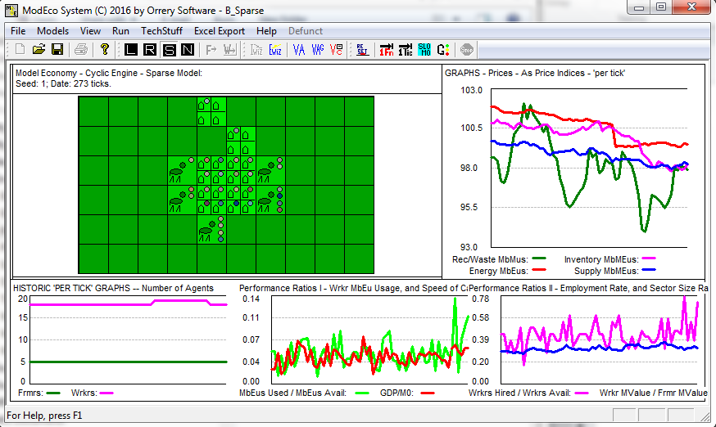
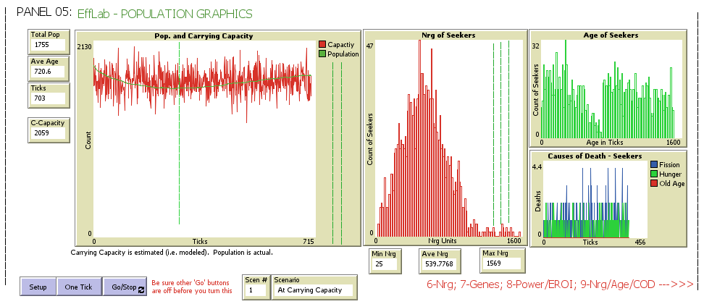
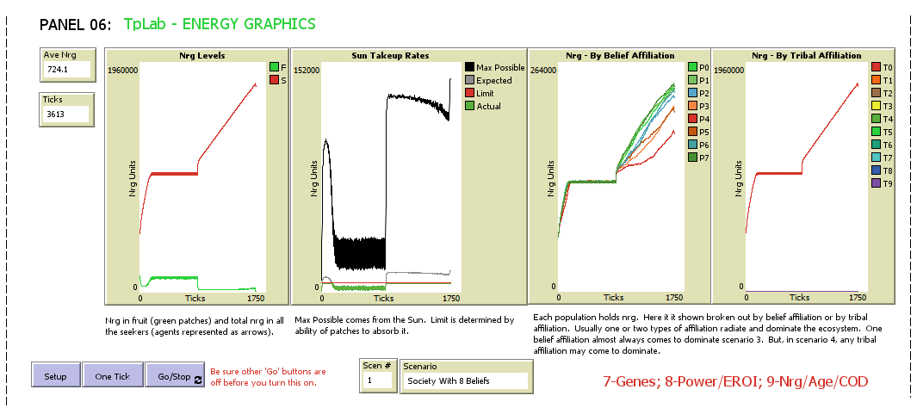
My Personal History
Studying Evolving Economies
2010 – ModEco – A Farming Economy in which trading strategies evolve.
2016 – EffLab – Efficiency in use of energy and/or money in an evolving system.
2017 – TpLab – Evolution of Social Beliefs.

Slide 8
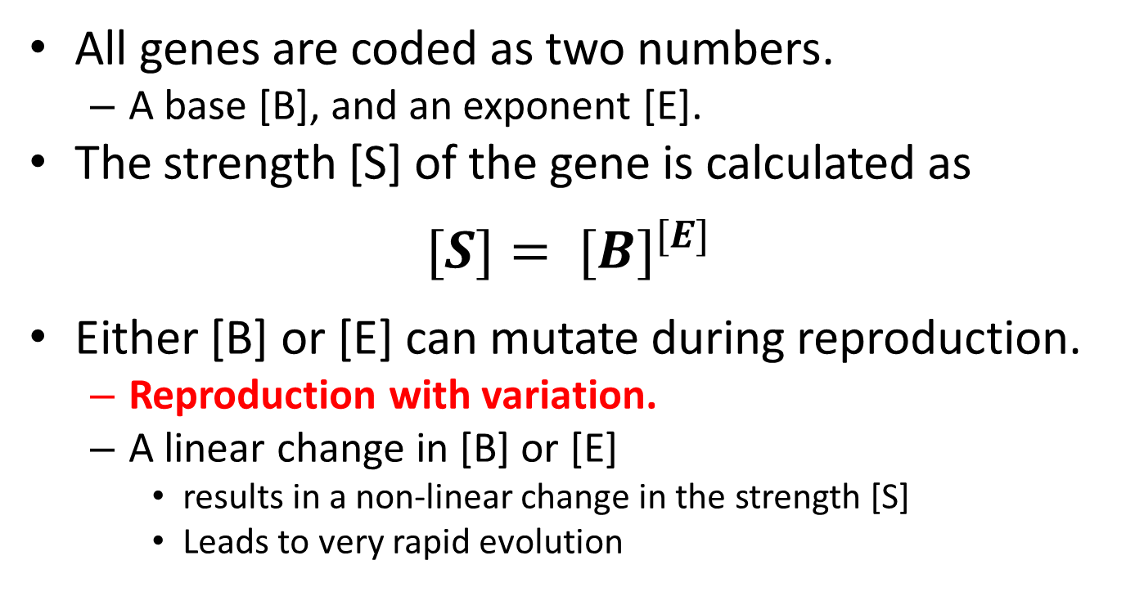
Dr Michael Palmiter’s 1st Great Innovation
Exponential Coding Schema
All genes are coded as two numbers.
  A base [B], and an exponent [E].
The strength [S] of the gene is calculated as
$$[S]= {[B]}^{[E]}$$
Either [B] or [E] can mutate during reproduction.
  Reproduction with variation.
  A linear change in [B] or [E]
    results in a non-linear change in the strength [S]
    Leads to very rapid evolution
Call these “Palmiter Genes”

Slide 9
Dr Michael Palmiter’s 2nd Great Innovation
Movement Genes
Movement is controlled by a normalized probability distribution with eight genes.
  Competition is for energy (the scarce resource).
  Behavior in 2D space is a random walk.
  Location of energy within the 2D space is random.
  Access to energy is stochastic (natural selection - many failures, a few successes).
I PLACE THESE INTO A SINGLE “CHROMOSOME”
C1 – MOVEMENT GENES

Slide 10

Movement Genes
Some Definitions and Terminology
  Each agent has a heading – a direction.
  There are eight movement genes, only one will be activated per tick of the model, with probability of activation = P_{i}.
  All changes in heading are measured from the current heading.
  (P₀) F – Forward – Turn 0° to the right, then step forward.
  (P₁) FR – Forward and Right – Turn 45° to the right, then step forward.
  (P₂) R – Right – Turn 90° to the right, then step forward.
  (P₃) BR – Backward and Right – Turn 135° to the right, then step forward.
  (P₄) B – Backward – Turn 180° to the right, then step forward.
  (P₅) BL – Backward and Left – Turn 225° to the right, then step. forward
  (P₆) L – Left – Turn 270° to the right, then step forward.
  (P₇) FL – Forward and Left – Turn 315° to the right, then step forward.

Slide 11
Palmiter’s Movement Coding Schema
When gene 4 is activated – turn 180° then step.
L
(P₆)
FL
(P₇)
F
(P₀)
F – FRONT – TURN 0°
B – BACK – TURN 180°
(P₄) is the probability that gene 4 will be activated for this tick.
Gene 4 says turn 180°, then take a step.
BL
(P₅)
FR
(P₁)
B
(P₄)
BR
(P₃)
R
(P₂)

Slide 12
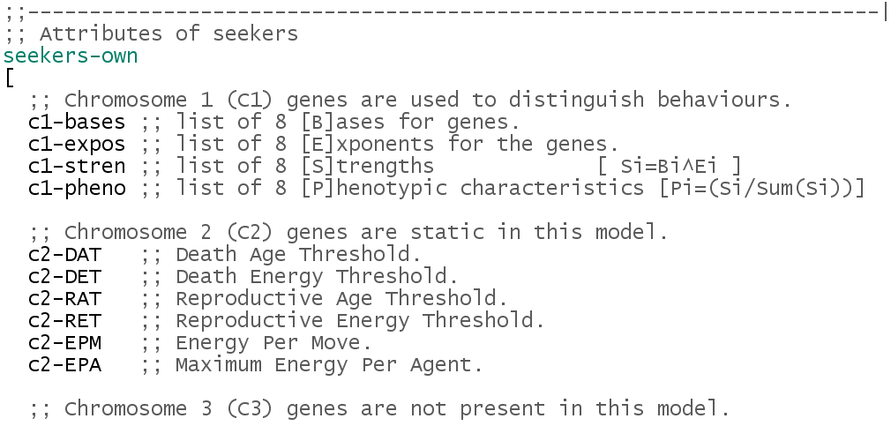
The Genes of Chromosome #1
The Movement Genes

Slide 13
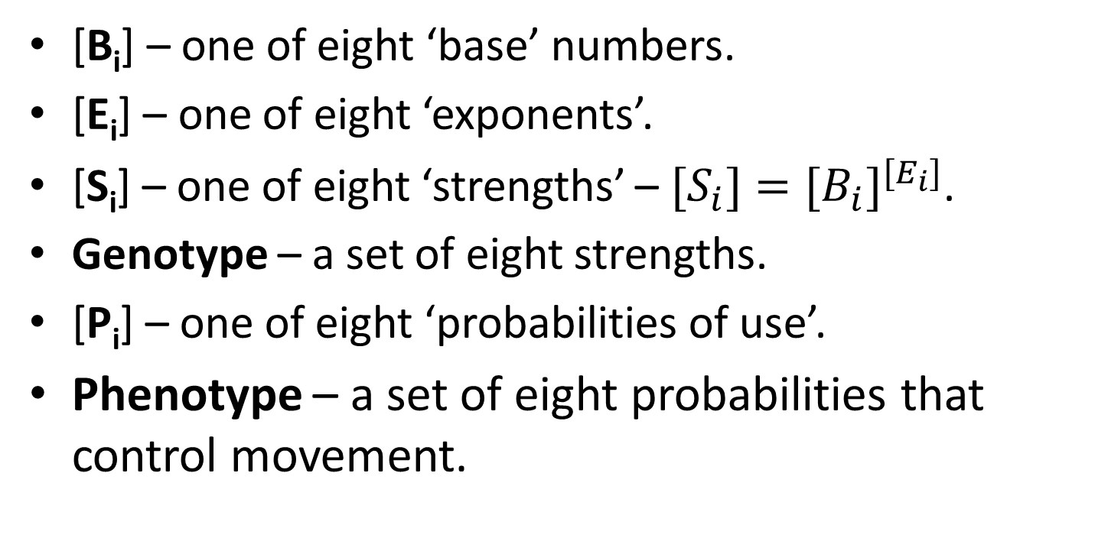
The Genes of Chromosome #1
The Movement Genes
Some Definitions and Terminology
  [B_{i}] – one of eight ‘base’ numbers.
  [E_{i}] – one of eight ‘exponents’.
  [S_{i}] – one of eight ‘strengths’ – ${{{[S}_{i}]=[B}_{i}]}^{[E_{i}]}$.
Genotype – a set of eight strengths.
  [P_{i}] – one of eight ‘probabilities of use’.
Phenotype – a set of eight probabilities that control movement.
https://www.comses.net/codebases/?query=boyle

Slide 14
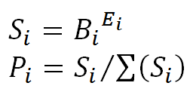
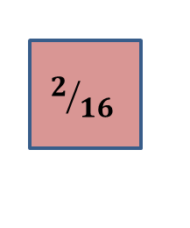
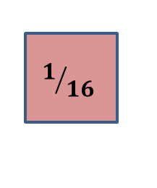
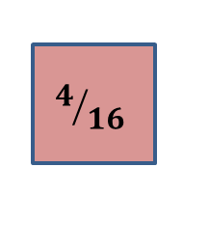
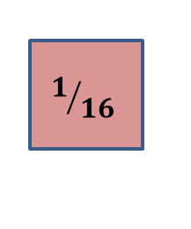
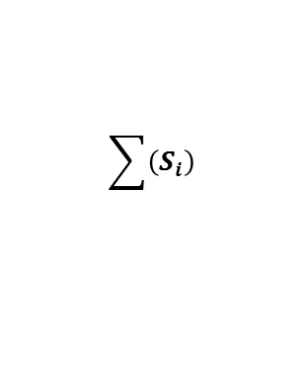




Palmiter’s Movement Coding Schema
i = 0 1 2 3 4 5 6 7
F
FR
R
BR
B
BL
L
FL
Turn Label
Turn Amount
8 Base Values
8 Exponent Values
Genotype
Phenotype
0
45
90
135
180
225
270
315
B_{i}
2
2
2
2
2
2
2
2
E_{i}
0
1
1
0
2
1
1
1
S_{i}
1
2
2
1
4
2
2
2
16
$$\sum{\left(S_{i}\right)}$$
P_{i}
$$1/{16}$$
$$2/{16}$$
$$2/{16}$$
$$1/{16}$$
$$4/{16}$$
$$2/{16}$$
$$2/{16}$$
$$2/{16}$$

Slide 15
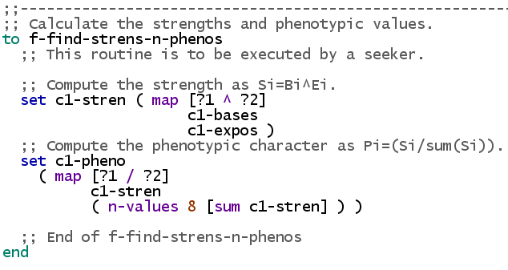
Palmiter’s Movement Coding Schema

Slide 16
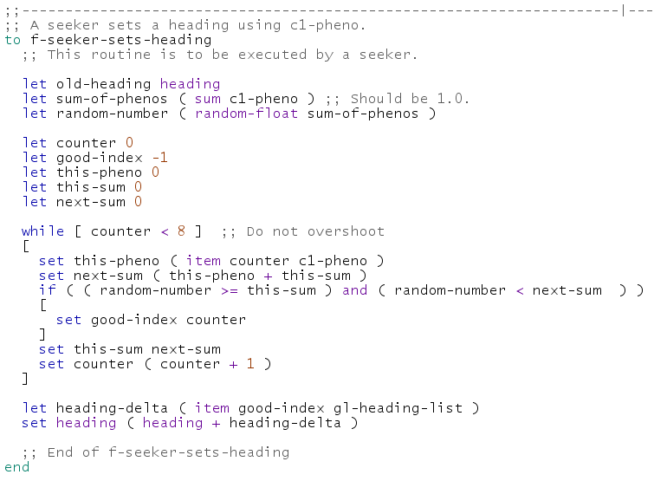
Palmiter’s Movement Coding Schema

Slide 17
Dr Michael Palmiter’s
Third Great Innovation
Life Cycle Functions are controlled by six parameters, which I encode in six Palmiter genes in a separate chromosome.
These control birth, death, energy consumption, and adult size. (These create the circumstances for natural selection.)
I PLACE THESE INTO A DIFFERENT “CHROMOSOME”
C2 – LIFE CYCLE FUNCTION GENES

Slide 18
The Genes of Chromosome #2
The Biophysical Life Function Genes
Control Natural Selection of Advantageous Traits

Slide 19
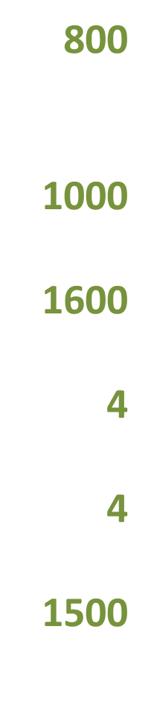
Palmiter’s Life Cycle Functions
Natural Selection of Advantageous Traits
RAT (Reproductive Age Threshold) - A bug cannot reproduce until older than this.
RET (Reproductive Energy Threshold) - A bug cannot reproduce until this healthy.
DAT (Death Age Threshold) - A bug dies if older than this.
DET (Death Energy Threshold) - A bug dies if it is too hungry.
EPM (Energy Per Move) - Energy expended by a bug on each move.
EPA (Energy Per Agent) - Maximum energy a bug can collect and carry.

Slide 20
Models With Palmiter Genes
PSoup – https://www.comses.net/codebases/5594/releases/1.0.0/
ModEco – https://www.comses.net/codebases/5599/releases/1.0.0/
TpLab – https://www.comses.net/codebases/5601/releases/1.0.0/
EffLab –
SimEvo –
Other Evolutionary Models
Oamlab - https://www.comses.net/codebases/4525/releases/1.1.0/
MppLab - https://www.comses.net/codebases/5596/releases/1.0.0/
Other Economic Models
Eilab - https://www.comses.net/codebases/f59677e2-392b-4c12-9beb-036323ffce85/releases/1.4.0/
CmLab - https://www.comses.net/codebases/5603/releases/1.0.0/
Contact: Orrery@Rogers.Com
https://www.comses.net/codebases/?query=boyle

Slide 21
Hip Pocket Slides
X06

