Slide 1
Modeling EROI
Computationally and Mathematically
THIS IS VERSION 9 OF THIS SLIDE DECK. SOME OF THE INCLUDED SLIDES WERE SUPPRESSED DURING MY PRESENTATION, TO FIT THE PRESENTATION INTO THE ALLOCATED 30 MINUTES. MOST OF THOSE SUPPRESSED SLIDES HAVE BEEN RESTORED, WITH A FEW AT THE END IN THE ‘HIP POCKET’ SECTION. THE TEXT OF MY PRESENTATION HAS BEEN ADDED IN THE NOTES PAGES.
DUE TO MY USE OF ANIMATION, A SIMPLE PRINTED COPY OF THE SLIDES IS NOT ALWAYS READABLE. FOR BEST VIEWING, PRINT THE NOTES PAGES, AND READ THE TEXT IN THE NOTES PAGES AS YOU FLIP THROUGH A SLIDE SHOW.
Garvin H Boyle
ISBPE
19th June 2017
Orrery-software.webs.com
Orrery@Rogers.com
A00
Notes:
Good afternoon. My name is Garvin Boyle. I am going to talk this afternoon about the modeling of EROI, both
{CLICK}
computationally, and
{CLICK}
mathematically.
{CLICK}

Slide 2
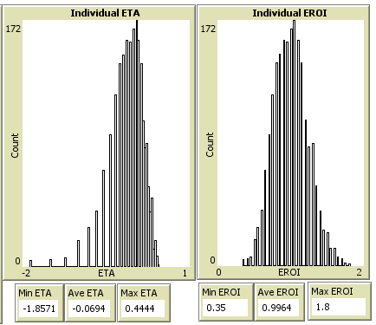
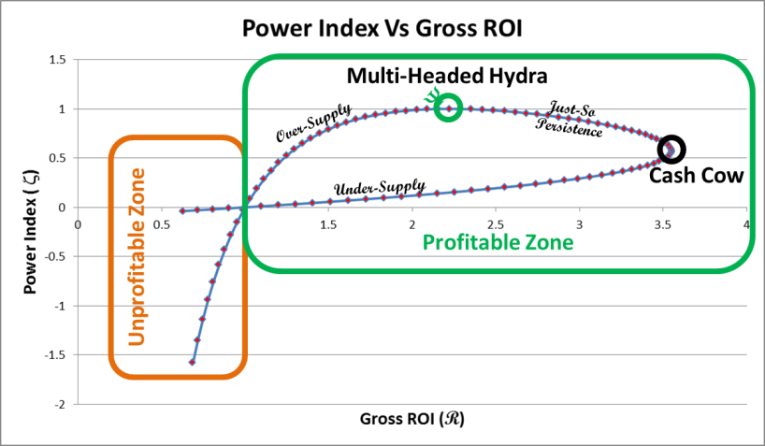
Modeling EROI
Computationally and Mathematically
Garvin H Boyle
ISBPE
19th June 2017
Orrery-software.webs.com
Orrery@Rogers.com
A01
Notes:
Good afternoon. My name is Garvin Boyle. I am going to talk this afternoon about the modeling of EROI, both
{CLICK}
computationally, and
{CLICK}
mathematically.
{CLICK}

Slide 3
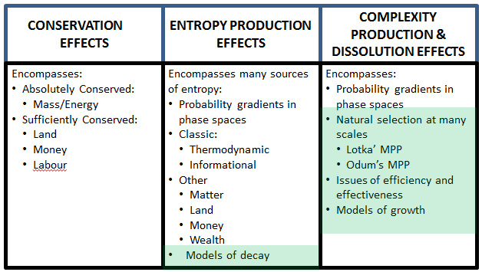
Outline of Presentation
Introduction/Context
Computational Demonstrations
  Brief Description of Model Ecosystem
  Demonstration of evolving population
  Demonstration of system-level behaviour
  Demonstration of Jevon’s Paradox
Mathematical Explorations
  Definitions
    Micro-Factors of Production and ICBT Curve Sets
    Efficiency (η), Return on Investment (R), Power (ξ)
  Goldilocks Curves
  Galbraith’s Theory of the Firm
  Growth and Decay – Two Competing Paradigms
  Metabolic Growth – Discrete-time formulae
A02
Notes:
I will start with a description of the source of my interest and the context of my studies.
{CLICK}

Slide 4
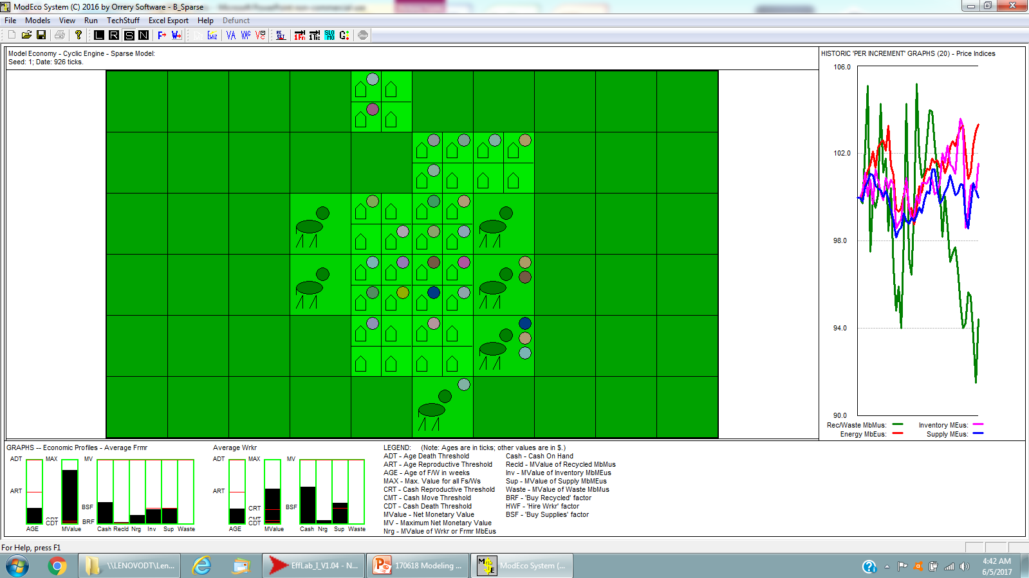
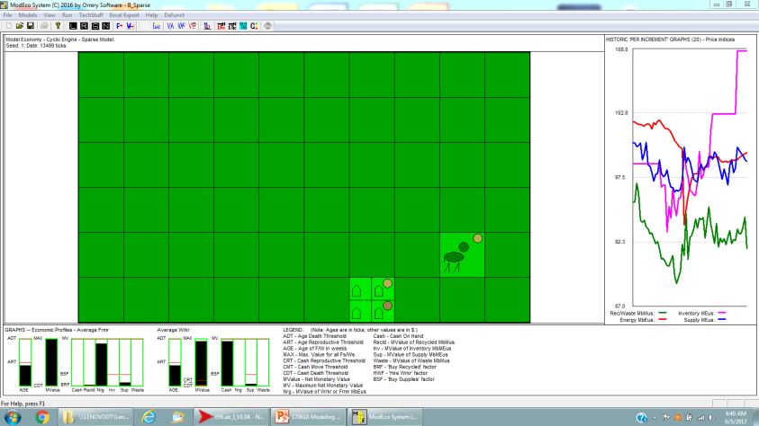
Why I First Came to a BPE Conference!
ModEco:
2010
Flourishing agrarian economy
Plenty of food
Plenty of Energy
Should run forever
BUT:
Not sustainable
Almost always crashes mysteriously
Price/Value gap emerges, causing price instability
I COULD NOT FIND AN ANSWER IN NCE.
Boyle, Garvin H (2017, April 13). "01a ModEco V2.05 – Model Economies – In C++" (Version 3). CoMSES Computational Model Library.
Retrieved from: https://www.openabm.org/model/3613/version/3
A03
Notes:
Back in 2010 I developed a hybrid model economy. It was to be a flourishing agrarian society in which there was plenty of food and energy which should have run forever.
{CLICK}
But, surprisingly, it was not sustainable, and I could not make it sustainable without taking extreme measures.
{CLICK}
A gap would emerge between the price of food and its intrinsic value. I could not find an answer in Neoclassical Economic theory.
{CLICK}

Slide 5
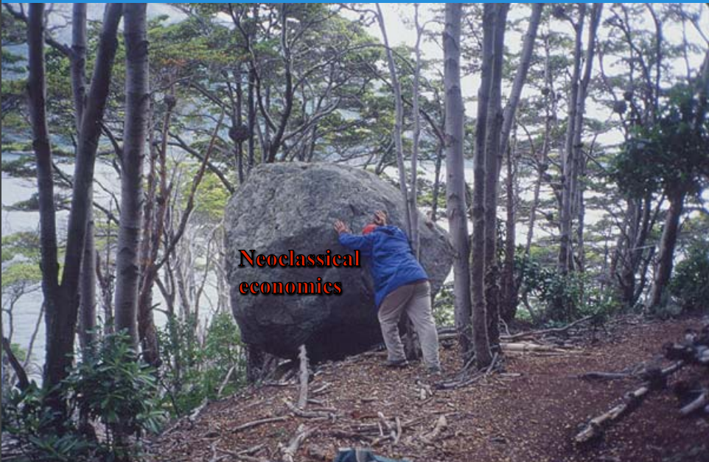
Dr Hall’s Inspirational Photo
4th BPE Conference, Vermont, 2012
A04
Notes:
Then, in 2012 I attended the 4th BPE conference in Vermont where I saw this tremendously inspirational slide showing Dr Hall pushing the NCE isolate off of the brow of the hill. I thought, this is a place where I might find some answers.
And, so, I have been coming to BPE conferences since.
{CLICK}

Slide 6
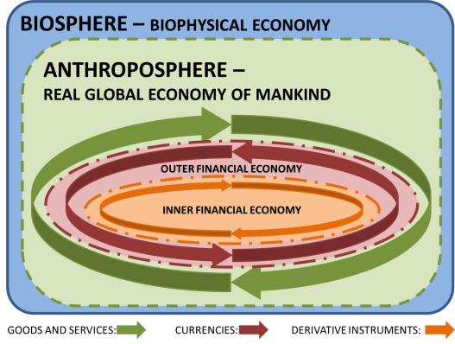
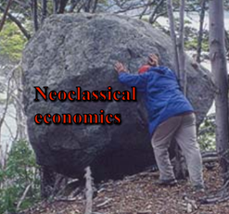
Situating My Interests
Sustainable Modern Economic System
Biophysical Perspective
  Enigmatic phenomena
    Time value of money
    Price/Value paradox
    Jevon’s paradox
    Sources of complexity
?!
A05
Notes:
Let me provide the context of my interest..
{CLICK}
I study the dynamics of economic systems. The goal of my work is to identify and understand the necessary and sufficient conditions to model a complete sustainable modern economy.
{CLICK}
My models are all constructed from the biophysical perspective.
{CLICK}
And focused on those things that Neo-Classical Economic Theory is unable to explain.
{CLICK}

Slide 7
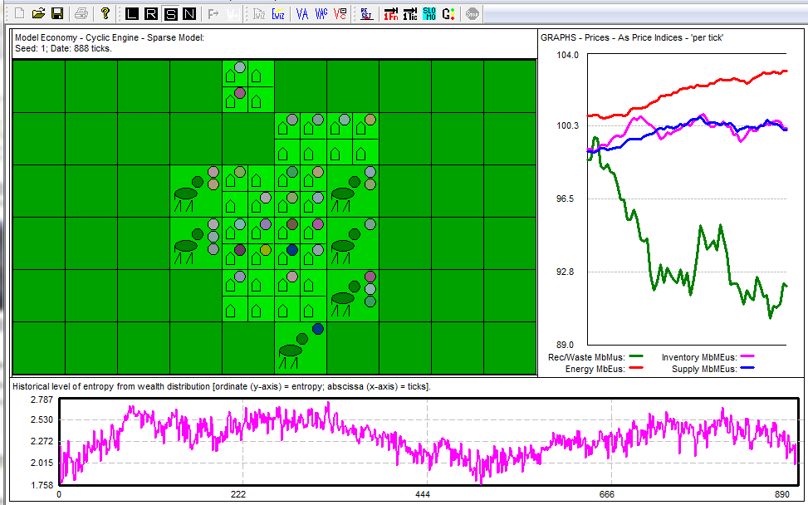
My Approach
Identify economic phenomena that do not appear to be well-addressed in NCE.
Build computational models in which the dynamics of interest are demonstrated.
Seek insight into how the dynamics operate, and their theoretical implications.
A06
Notes:
My approach has been:
{CLICK}
To identify dynamic phenomena that seem to occur in economic systems but do not appear to be addressed very well in NCE theory;
{CLICK}
Then to build computational models in which the dynamics of interest are demonstrated; and
{CLICK}
Then to seek insight into how those dynamics operate, and the theoretical implications.
{CLICK}

Slide 8
My Emerging Vision
Framework of Bio/Eco Dynamics
CONSERVATION
EFFECTS
ENTROPY PRODUCTION
EFFECTS
COMPLEXITY PRODUCTION & DISSOLUTION EFFECTS
Encompasses:
Absolutely Conserved:
  Mass/Energy
Sufficiently Conserved:
  Land
  Money
  Labour
Encompasses many sources of entropy:
Probability gradients in phase spaces
Classic:
  Thermodynamic
  Informational
Other
  Matter
  Land
  Money
  Wealth
Models of decay
Encompasses:
Probability gradients in phase spaces
Natural selection at many scales
  Lotka’ MPP
  Odum’s MPP
Issues of efficiency and effectiveness
Models of growth
A07
Notes:
This is the emerging vision of how hybrid ecological systems and economies function.
{CLICK}
First there are conservation effects, such that certain key quantities are conserved. In ecology the quantity mass/energy is absolutely conserved, and that is the foundation which leads to the emergence of other powerful stochastic phenomena. In economics other quantities are ‘sufficiently well conserved’ to provide an analogous foundation so that those same stochastic phenomena emerge as powerful forces in economic systems.
{CLICK}
Next, the production of entropy is an ubiquitous and potent phenomenon that was first discovered and thoroughly formulated in the study of isolated thermodynamic systems, but is apparently equally active in economic systems.
{CLICK}
And third – the production and dissolution of complexity in both ecological and economic systems is an area of great interest and research activity now. Many have proffered the existence of and need for a so-called ‘4th law of thermodynamics’.
{CLICK}
It is in this area that much of my presentation will be focused today.
{CLICK}

Slide 9
Status
Study is ongoing
Results are interim and partial
This presentation has a tight focus on one small aspect.
Feedback of any kind would be greatly appreciated.
A08
Notes:
The study is ongoing, the results partial, the presentation today is on one small aspect of this vision. And, of course, feedback would be greatly appreciated.
{CLICK}

Slide 10
Outline of Presentation
Introduction/Context
Computational Demonstrations
  Brief Description of Model Ecosystem
  Demonstration of evolving population
  Demonstration of system-level behaviour
  Demonstration of Jevon’s Paradox
Mathematical Explorations
  Definitions
    Micro-Factors of Production and ICBT Curve Sets
    Efficiency (η), Return on Investment (R), Power (ξ)
  Goldilocks Curves
  Galbraith’s Theory of the Firm
  Growth and Decay – Two Competing Paradigms
  Metabolic Growth – Discrete-time formulae
A09
Notes:
Now we move on to a presentation of the results of one of my ecological models, EffLab, with a focus on measurements of efficiency.
{CLICK}

Slide 11
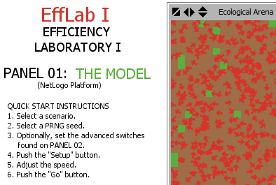
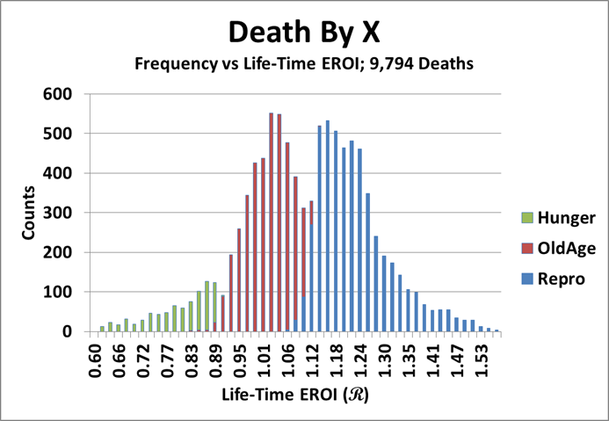
Efficiency Laboratory #I
Agent-based model – seekers:
  Are born,
  Seek and compete for food,
  Reproduce (and die) during fission, or
  Die of hunger or old age.
Since reproduction is via binary fission, at carrying capacity:
  50% of seekers will successfully reproduce via fission.
  50% of seekers will die of hunger and old age, and
The seekers of fruit evolve
The system evolves
A10
Notes:
The ‘Efficiency Laboratory” is an agent-based model in which small organisms (represented by the little red arrows in the arena) motor about seeking fruit. These organisms are blind but can develop an heuristic search pattern. As the Sun pours its energy into the arena, small patches of fruit having 40 units of energy (small green spots) appear. The ‘seeker of fruit’ that first stumbles upon the fresh fruit may eat it. These seekers live full lives cradle-to-grave. They are born, they compete for food, and, if they capture sufficient food, they reproduce. Otherwise, they die of hunger or old age.
{CLICK}
Since reproduction is via fission when the mother collects and stores 1,000 units of energy, at carrying capacity only about 50% of all offspring can live to reproduce successfully.
{CLICK}
The other 50% must die of hunger or of old age.
{CLICK}
The seekers of fruit evolve to develop more effective search heuristics.
But, at the same time, the system of seekers also develops in parallel.
{CLICK}

Slide 12
Efficiency Laboratory #I
Metabolic Functions of Seekers are Controlled by Six Individual Biophysical Parameters (or genes):
DAT – Death Age Threshold (1600 ticks) – Seekers cannot exceed this age.
  Controls death by old age
DET – Death Energy Threshold (4 eu) – Seekers cannot live with less energy.
  Controls death by hunger
RAT – Reproductive Age Threshold (800 ticks) – Age of reproductive maturity.
  Prevents immature reproduction
RET – Reproductive Energy Threshold (1000 eu) – Required energy for repro.
  Prevents sickly reproduction.
EPM – Energy Per Move (4 eu) – Mandatory metabolic cost per move.
  Enforces metabolic costs
EPA – Energy Per Agent (1500 eu) – Maximum energy (size limit)
  Suppresses ‘gigantism’.
◻
✓
◻
✓
◻
✓
◻
✓
◻
✓
◻
Genes that control the way seekers die.
◻
✓
Genes that evolve in THIS “EffLab I” model to demonstrate Jevon’s Paradox.
◻
✓
A11
Notes:
The metabolic functions of the seekers are controlled by six genes.
{CLICK}
Four of these genes control when and how they die. Time moves forwards in discrete units called ‘ticks’. If a seeker is older than 1600 ticks, then it dies of old age. If the seeker has less than four units of energy, it dies of hunger. To reproduce, a seeker must be at least 800 ticks old, and must have at least 1,000 units of energy. So, when it reproduces by fission, each daughter seeker receives at least 500 units of energy.
{CLICK}
One of these genes is of direct interest in the study of efficiency. EPM determines the mandatory expenditure of metabolic energy for each move that a seeker makes, for each tick. A typical seeker, on startup, must expend exactly 4 units of energy with each move – i.e. with each tick of the model. I have allowed the value of this gene to evolve over time in this model to see whether Jevon’s Paradox could be demonstrated, and to be able to explore why and how it happens.
{CLICK}

Slide 13





Efficiency Laboratory #I
“Per Tick” cycle:
  System energizes as 40 eu of fruit grows in random places
  Seekers move at an investment of EPM eu (⬆EI)
  Seekers feed on fruit with a possible return of 40 eu (⬆ER)
  Seekers may reproduce via fission (if old enough and well enough)
  Seekers may die (of hunger or old age)
Cycle through: all seekers for each step,
all five steps for each tick of the clock.
R = ER/EI can be measured for:
  All individual agents – Instantaneous
  All individual agents – Life-Time Efficiency
  For the system as-a-whole
A12
Notes:
With each tick of the model, five things happen.
{CLICK}
First, the Sun pours its energy on the arena and fruit appears in random places, in patches with 40 units of energy each.
{CLICK}
Then the seekers go through their activities for the tick. They move, each expending EPM units of energy according to their EPM gene. This is the source of ‘energy invested’. They feed on fruit if they happen to find some, and this is the source of the ‘energy returned’. Then seekers may reproduce if old enough and healthy enough. And seekers then die, if too old or too hungry.
{CLICK}
In steps 2 through 5 all seekers are activated or checked in every tick.
{CLICK}
And all five steps are performed for each tick of the clock.
{CLICK}
Energy Returned on Energy Invested can be calculated in at least four ways. For each seeker I can calculate the instantaneous EROI (denoted as R). Well, it’s not exactly instantaneous as I must take a moving average to smooth the data.
{CLICK}
Or, for each seekers I can calculate the life-time average R as the sum of all fruit gathered divided by the sum of all energy expended.
{CLICK}
Or, I can calculate R on a system basis in two ways. I can simply average the instantaneous R for all seekers, or I can calculate an instantaneous R as all fruit eaten this tick, divided by all energy expended this tick.
{CLICK}

Slide 14
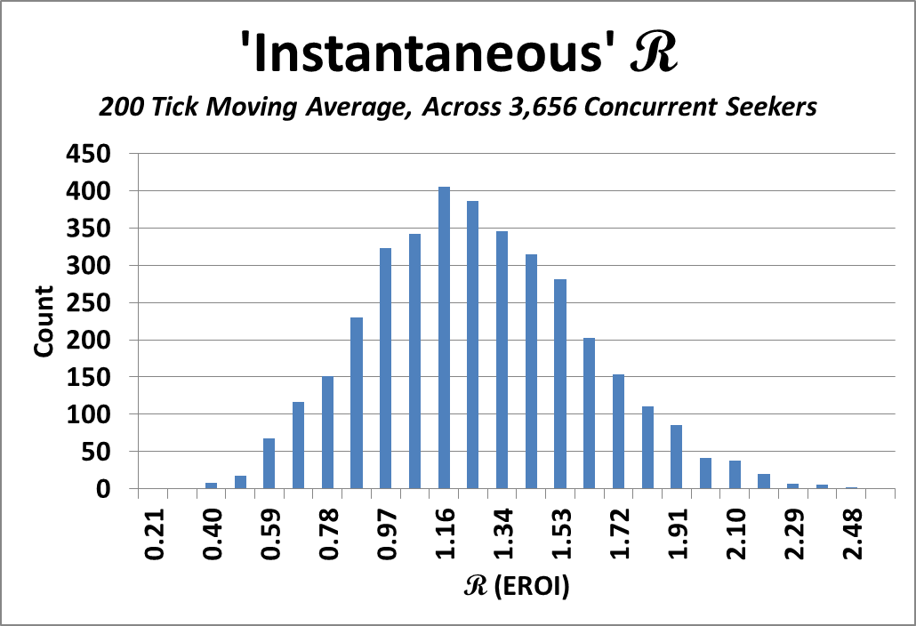
Instantaneous Efficiency
R = 1
Why NYSE is a bad indicator of economic health.
170606 Ind-EROI All Seekers R1
A13
Notes:
So, when I run the model until it reaches a stationary state, I can display the instantaneous R for all seekers currently alive, and I get this sort of distribution.
{CLICK}
R = 1 is located here. Notice that about one third of the agents are expending less energy than they are collecting. They are on the road to starvation. About two thirds would seem to be doing well. Note that the mode of this distribution is NOT near 2, but very close to 1.16.
{CLICK}
Just before I move on from this graph, if you have ever wondered why the New York Stock Exchange is a poor indicator of the health of the economy, this about this. The NYSE only lists those corporations that are doing well and have a long-term positive return on investment. Of course it will always go up-up-up, instead of flat-flat-flat, which is what you will see in the next slide.
{CLICK}

Slide 15
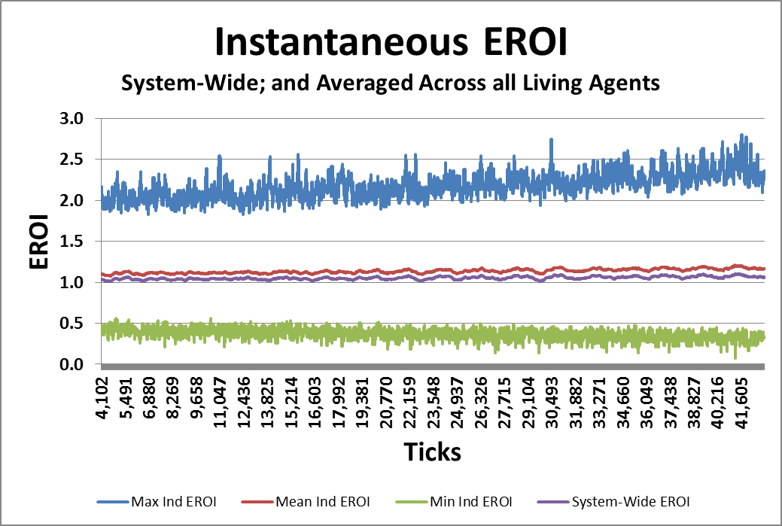


Instantaneous Efficiency
A14
Notes:
In the previous slide you saw the population of seekers for one tick of the clock at stationary state. Here you see a historic presentation for ticks 4,000 to 40,000 as the system evolves. Four lines are plotted: The maximum, mean and minimum instantaneous value of R for all living seekers, and the calculated instantaneous R for the system as-a-whole. Note that the mean R is close to 1.16, but the system value is consistently lower – close to 1.0 but just above 1.0.
My trophic chain in this model has only two links – herbs and herbivores. Lotka’s logic tells me that it should be exactly 1.0. On thinking about it I realized that, when seekers die of hunger or old age, by model was simply discarding the contained unused energy into the waste heat sink. In nature, decomposers and detrivores would consume that energy. I was missing the key role of these organisms.
{CLICK}

Slide 16
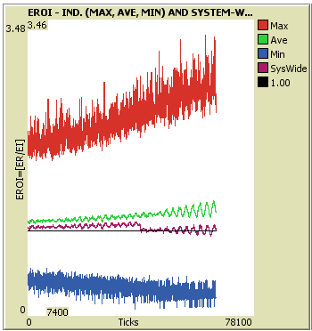
Instantaneous Efficiency
Raw Graph from “EffLab I”
NOTE:
Min and Max are spreading, but Mean is consistently above R = 1.
System-Wide R is above 1, but drops to about 1 when Decomposers and Detrivores are included.
They are the ultimate consumers, the ultimate Point Of Use, taking R down to 1.
A15
Notes:
This is a raw graph from my model. You can see that at about 40,000 ticks I inserted the effects of decomposers and detrivores, and the system-as-a-whole value of R fell to oscillate around the value 1.0, as the logic in Lotka’s paper of 1922 implies it should.
In some sense, the decomposers and detrivores are the ultimate ‘point-of-use’ users in the trophic chain, and they degrade whatever remnants of energy may remain in useful form when the rest of the trophic chain has had its turn.
{CLICK}

Slide 17
Distributions of Life-Time Efficiencies
Broken Out By Type of Death
R = 1
170603 Data Manipulations re EffLab I R1.docx
A17
Notes:
Now, let’s look quickly at the distribution of the life-time efficiencies. This data was collected for over 9,000 seekers in a stationary state system.
{CLICK}
The returns and investments over the life of the seeker was compiled, but, of course, this can only be done once they are dead. At that time, I can segregate the data by cause of death.
{CLICK}
R = one is located here. The seekers that died of hunger are coloured green. They each started life with at least 500 units of energy, since each mother had to have at least 1,000 units to undergo fission. They squandered it all, and died of hunger. The blue seekers, on the other hand, started with 500 units and eventually grew to hold 1,000 units, and underwent fission. The red ones, died of old age. They gathered enough energy to stay alive to age 1600 ticks, but never managed to exceed the threshold value of 1,000 units of energy, and so could never reproduce.
I am afraid that, at this moment, I cannot explain the obvious notches that appear between the green, red and blue portions of this distribution. Compare this distribution with the distribution for all current seekers.
{CLICK}

Slide 18
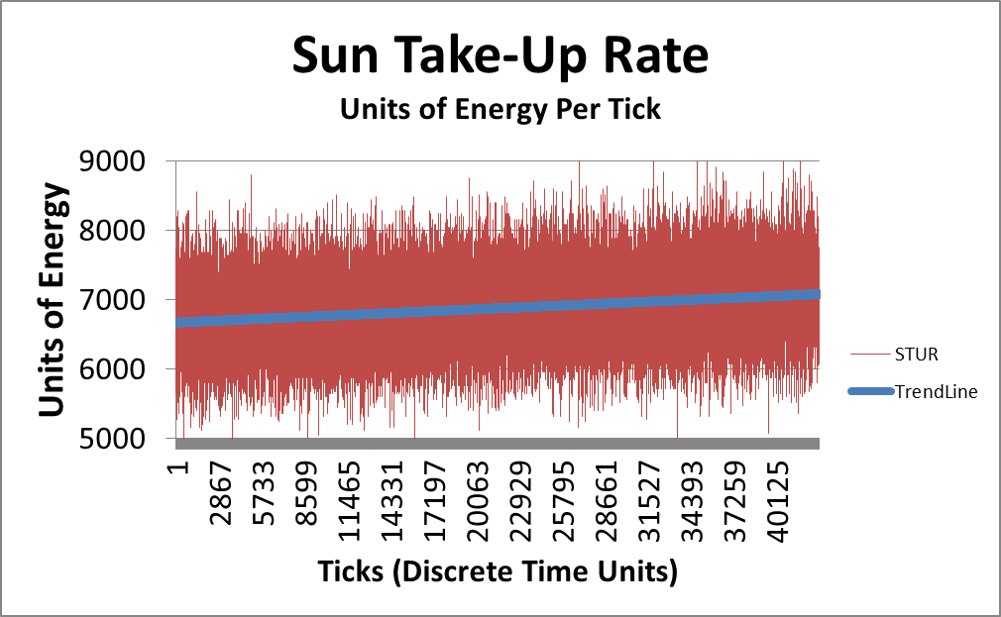
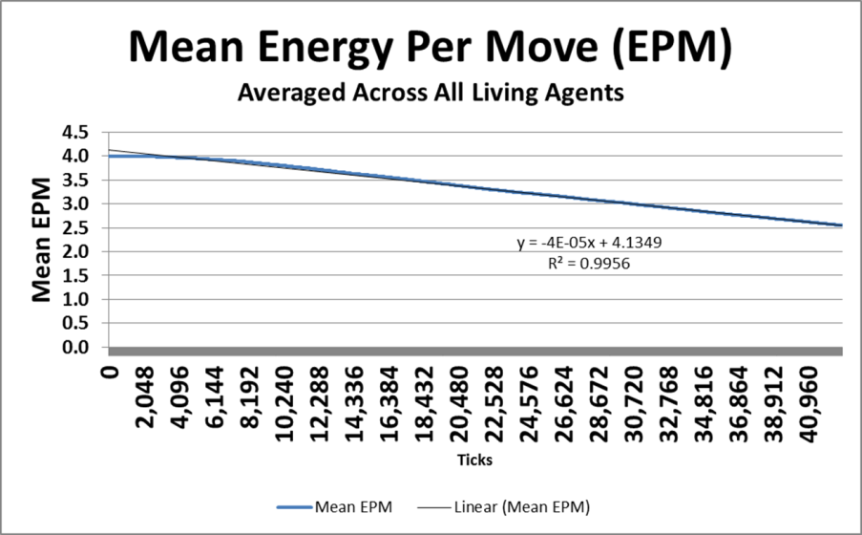


Jevon’s Paradox
In economics, the Jevons paradox […] occurs when technological progress increases the efficiency […], but the rate of consumption of that resource rises because of increasing demand. The Jevons paradox is perhaps the most widely known paradox in environmental economics. However, governments and environmentalists generally assume that efficiency gains will lower resource consumption, ignoring the possibility of the paradox arising.
Wikipedia
In economics, the Jevons paradox […] occurs when technological progress increases the efficiency […], but the rate of consumption of that resource rises because of increasing demand. The Jevons paradox is perhaps the most widely known paradox in environmental economics. However, governments and environmentalists generally assume that efficiency gains will lower resource consumption, ignoring the possibility of the paradox arising.
Wikipedia
In economics, the Jevons paradox […] occurs when technological progress increases the efficiency […], but the rate of consumption of that resource rises because of increasing demand. The Jevons paradox is perhaps the most widely known paradox in environmental economics. However, governments and environmentalists generally assume that efficiency gains will lower resource consumption, ignoring the possibility of the paradox arising.
Wikipedia
https://en.wikipedia.org/wiki/Jevons_paradox
A19
Notes:
There is one last set of graphs arising out of my agent-based computer model. In Wikipedia I find this brief description of Jevon’s Paradox. You recall I said that I allowed the EPM gene of the seeker (which determines the energy expended per move by the seeker) to evolve over time.
{CLICK}
In this case I consider ‘evolutionary progress’ to have the equivalent effect of ‘technological progress’. Note that there is downward pressure exerted by evolutionary forces on the mean value of EPM over the course of 40,000 ticks of the model. The slope is not steep, but there is definitely constant movement towards more and more efficiency of the movement of the seekers over time.
{CLICK}
But, I can also measure the overall energy take-up rate of the system as-a-whole simply by summing the energy in the fruit deposited each turn. It would appear that Jevon’s Paradox is active in this model. Most explanations for Jevon’s paradox involve supply, demand, and changes induced in peoples behaviour due to price movements. In this instance, there are no prices. The seekers evolve more effective search heuristics, and more efficient movement. The ‘Red Queen Effect’ ensures that each generation must nevertheless compete for survival. But, the result is increased flow of energy through the system, consistent with Lotka’s arguments of 1922, and consistent with Jevon’s observations.
{CLICK}

Slide 19
Scope of My Computational Demonstrations Re EROI:
Build a model of a simple sustainable ecosystem
Define instantaneous, life-time, and system-wide R
Collect data over 65,000 ticks (8,000 generations)
Show distribution of R at one instant
Show development of distribution of R over time
Contrast individual R with system-wide R, with effects of D&D
Demonstrate the connection between R and mode of death
Demonstrate evidence of Jevon’s Paradox operating in this extremely simple ecosystem
A20
Notes:
This complete the first part of my presentation based on the EffLab model.
{CLICK}

Slide 20
Outline of Presentation
Introduction/Context
Computational Demonstrations
  Brief Description of Model Ecosystem
  Demonstration of evolving population
  Demonstration of system-level behaviour
  Demonstration of Jevon’s Paradox
Mathematical Explorations
  Definitions
    Micro-Factors of Production and ICBT Curve Sets
    Efficiency (η), Return on Investment (R), Power (ξ)
  Goldilocks Curves
  Galbraith’s Theory of the Firm
  Growth and Decay – Two Competing Paradigms
  Metabolic Growth – Discrete-time formulae
  System boundaries – Eliminating externalities
A21
Notes:
{CLICK}
Now, as time allows, I would like to present some of my mathematical explorations. Unfortunately, I must first present a number of definitions.
{CLICK}

Slide 21
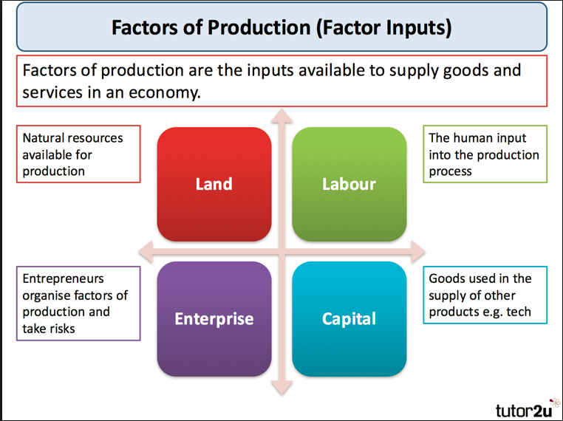
https://www.tutor2u.net/economics/reference/factors-of-production
A22
Notes:
You are probably all aware of the four factors of production that are used in economic theory. I have found these to be very difficult to work with in my economic models, largely because the definitions are too vague to be useful. Nevertheless, the concept of factors of production makes sense. So, for my models, I have concentrated on the effects of a single factor of production that I am calling a ‘micro-factor of production’, or an MFP.
{CLICK}

Slide 22
ICBT Curve Set Definitions
Micro-factor of production (MFP) – any single input that might be classified into one of the four major “factors of production”.
  E.g. “Number of Worker days”
ICB Curve Set – A set of three models of energy or capital flows, versus one MFP
  Independent Variable: Consumption of MFP.
    E.g. “Worker days”
  Dependent Variables: Income, Costs, and Benefits
A23
Notes:
An MFP is any single input that might be classified as one of the four major factors of production. An example would be number of worker days.
{CLICK}
I also wish to define something I am calling an ICB curve set. This is a set of three intersecting curves that model energy or capital flows as a function of one MFP.
{CLICK}
The independent variable is, of course, the MFP.
{CLICK}
The dependent variable is one of Income, Costs, or Benefits.
{CLICK}

Slide 23
Relationships – I, C, B & T
The role of Time
All variables are for time ΔT.
I(W) is gross income, expressed as a function of W (I.e. a function of the MFP).
C(W) is associated costs (or investments) – a function of W
B(W) is associated net benefits (or profits) – a function of W
A24
Notes:
Income is the gross income, expressed as a function of the level of consumption of the MPF for a given time period such as a day, a month, or a quarter.
{CLICK}
The costs are those associated with that income, also expressed as a function of the MFP. These can be viewed as operations and maintenance expenditures, as well as capital expenditures, associated with that income.
{CLICK}
And the benefits are those associated with the income, being the residual of Benefits equals Income minus Costs. Benefits can also be viewed as net profits, or net income.
{CLICK}

Slide 24
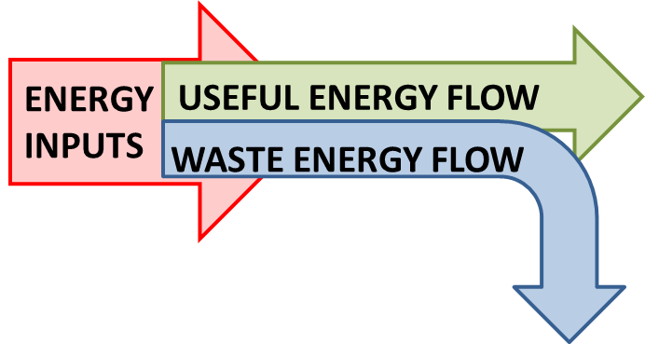

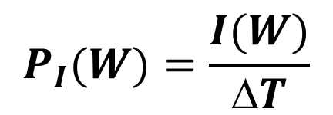
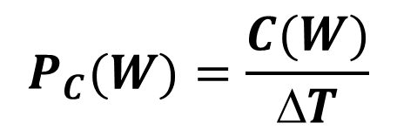
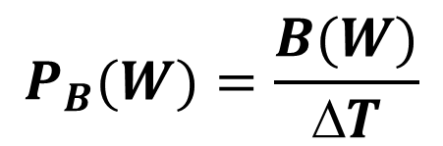
“Power” – Four definitions
Gross Power
Wasteful Power
Net Useful Power
$$P_{I}(W)=\frac{I(W)}{ΔT}$$
BIOPHYSICAL INTERPRETATION
$$P_{C}(W)=\frac{C(W)}{ΔT}$$
ECONOMIC INTERPRETATION
Useful Power Index
$$P_{B}(W)=\frac{B(W)}{ΔT}$$
, ξ∈[0, 1]
A25
Notes:
This leads directly to four definitions of power as follows:
{CLICK}
Gross power, the power of the income.
{CLICK}
Wasteful power, the power of the costs.
{CLICK}
Net useful power, the power of the benefits.
{CLICK}
And the useful power index, calculated as the net useful power divided by the maximum power of the benefits achieved over the entire domain of the MFP. I use this to normalize my graphs.
{CLICK}
Note that these have a biophysical interpretation when energy is conserved,
{CLICK}
and an economic interpretation when money is conserved.
{CLICK}

Slide 25
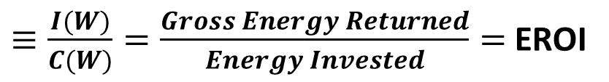
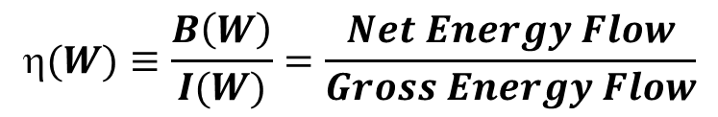
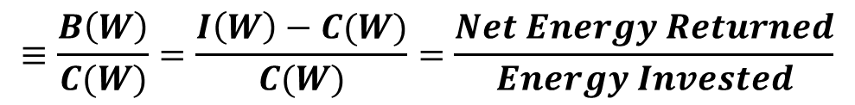
“Efficiency” – Three definitions
Gross Return on Investment
Net Return on Investment
Carnot’s Efficiency Eta (η)
R(w)
$≡\frac{I(W)}{C(W)}=\frac{Gross Energy Returned}{Energy Invested}=$ EROI
N(w)
$$≡\frac{B\left(W\right)}{C(W)}=\frac{I\left(W\right)−C(W)}{C(W)}=\frac{Net Energy Returned}{Energy Invested}$$
$$(W)≡\frac{B\left(W\right)}{I(W)}=\frac{Net Energy Flow}{Gross Energy Flow}$$
A26
Notes:
And then I have three definitions of efficiency, of which you are probably all aware.
{CLICK}
I denote the familiar EROI as capital R. This is the gross return on investment, as defined in Dr Hall’s book.
{CLICK}
Then there is the net return on investment.
{CLICK}
And there is the efficiency used by most engineers, which I will call Carnot’s efficiency to distinguish it from the other two. I denote it using the greek symbol eta.
Note that I have expressed each of these in terms of I, C and B in preparation for the next step.
{CLICK}

Slide 26
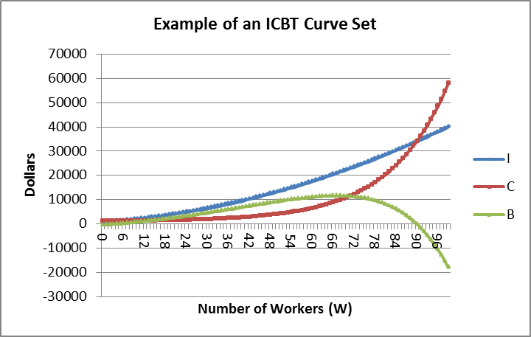
One Profitable Transaction?
Under-Supply
Over-Supply
Each and every predation event or business transaction defines a set of values (I, C, B and ΔT) and a set of efficiency measures (R, N and η).
A27
Notes:
Whether we are talking about energy within an ecosystem, or money within an economy, each transaction is associated with a single value of the MFP, and thereby defines a set of values of I, C and B, and an associated set of values for R, N and eta.
{CLICK}
If the level of consumption of the input (the MFP) is altered, you can expect different values for these parameters. For example, if the MFP is set to 66 in this example, then the values of I, C, B, R, N and eta are set, and B is at a maximum.
{CLICK}
If the MFP is less than 66, we have a case of under-supply.
{CLICK}
And, if the MFP is over 66, we have a case of over-supply.
{CLICK}

Slide 27
Profitable Domain
Profitable Transactions
Benefits are positive when income exceeds costs.
Persistence implies existence in ‘profitable domain’.
The role of time is implicit – All variables are flows per unit of time.
A28
Notes:
Note that when income exceeds costs the benefits are positive, and when income equals costs, the benefits are zero.
{CLICK}
So, for every ICB curve set associated with an MFP there may be a domain over which profits can be achieved. Any transaction within that profitable domain will produce profits, but is not necessarily persistent. Other competitors may be working with a better set of curves.
{CLICK}
But we can say that persistence of an organism or organization would imply that they must be operating within the profitable domain of their innate ICB curve set for this MFP.
{CLICK}
Again, the role of time is implicit.
{CLICK}

Slide 28
Two Paradigms?
Is one paradigm better than the other?
  The η-based paradigm has its roots in the work of Carnot, and is almost universally used by all engineers of energy-consuming systems and equipment.
  The EROI-based paradigm has its roots in economic theory, as adapted by Dr Hall for use in ecology and energetics, and is now almost universally used by ecologists and by analysts of energy-extraction industries.
Is there some easy way to reconcile or merge these two important and widely-used paradigms?
A29a
Notes:
We have these two paradigms of efficiency. Both are widely accepted and used. And the EROI measure has its economic counterpart ROI (or return on investment) for which the ratio is dollars over dollars, in place of Joules over Joules. That is a very widely used metric of corporate health in economics. They would seem, clearly, to be related, but the relationship between the two is not at all obvious.
Is there some way to reconcile these two measures of efficiency?
{CLICK}

Slide 29
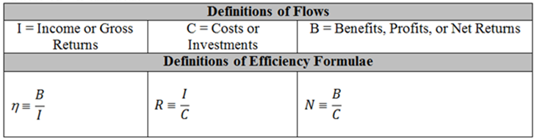
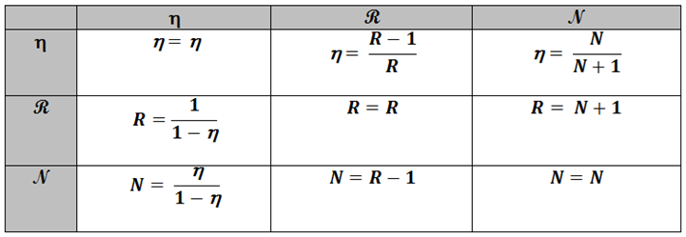
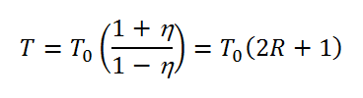
Relationships – R, N & η
Conversion Formulae
Δ
A29
Notes:
Now, I want to examine the relationship between these three measures of efficiency that are variously used in engineering, ecological, and economic studies.
{CLICK}
I can produce this nine-cell table of conversion formulae. You see – I can express eta in terms of eta, of R and of N.
{CLICK}
Three of these are tautological identity formulae and of no interest other than as place holders.
{CLICK}
Two of them are mere linear translations, and as such are fairly easy to understand and manipulate.
{CLICK}
So I can eliminate N as a formula of interest.
{CLICK}
That leaves R and eta as the two definitions of efficiency that remain of interest. And we have these two conversion formulae to work with.
{CLICK}
There is one more formula that is too cool to miss, though I do not work with it in the rest of the presentation. The time delta associated with an energy conversion in one instance is related to eta and R by this formula, when T-nought is a minimum time.
{CLICK}

Slide 30
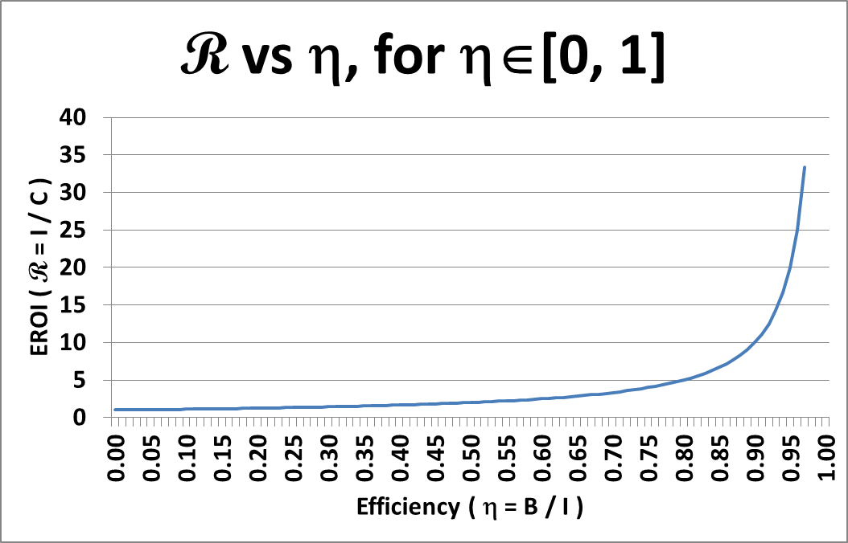


Relationship – R & η
The classic understanding of the domain of Carnot’s efficiency is η ∈ [0, 1].
R = 1 / ( 1 – η )
$$\lim_{η→0}\left(R\right)=1$$
$$\lim_{η→1}\left(R\right)={}_{}^{+}∞$$
If η ∈ [0, 1], then R ∈ [1, ⁺∞].
A30
Notes:
If Carnot’s efficiency is between zero and one, as is normally assumed, we can examine the impact on R.
{CLICK}
Here’s the conversion formula.
{CLICK}
That leads to this plot of R versus eta.
{CLICK}
As eta approaches zero, the limit of R is one.
{CLICK}
As eta approaches one, the limit of R is positive infinity.
{CLICK}
So we see the range of R is from 1 to infinity. That makes sense.
{CLICK}
Note the ‘knee’ in this graph.
{CLICK}

Slide 31
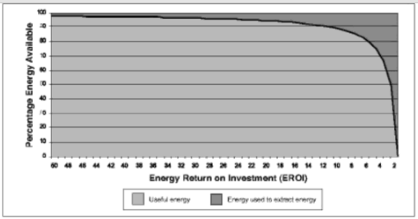
Classic Presentation of R “Knee Curve”
A31
Notes:
Those of you who have been to previous ISBPE conferences will recognize this more classic version of the knee graph associated with EROI.
{CLICK}
Here’s the knee.
{CLICK}

Slide 32
Outline of Presentation
Introduction/Context
Computational Demonstrations
  Brief Description of Model Ecosystem
  Demonstration of evolving population
  Demonstration of system-level behaviour
  Demonstration of Jevon’s Paradox
Mathematical Explorations
  Definitions
    Micro-Factors of Production and ICBT Curve Sets
    Efficiency (η), Return on Investment (R), Power (ξ)
  Goldilocks Curves
  Galbraith’s Theory of the Firm
  Growth and Decay – Two Competing Paradigms
  Metabolic Growth – Discrete-time formulae
  System boundaries – Eliminating externalities
A32
Notes:
That’s it for definitions – for now.
{CLICK}
We’ll move on to Goldilocks curves, Galbraith’s theory of the firm, and other problems as time allows.
{CLICK}

Slide 33
Maximum Power
Insight From Lotka’ Papers of 1922
System-wide chains of energy transformations can be rated for their total throughput of energy (I.e. P_{I}(W))
‘Natural Selection’ ensures the persistence of those system-wide chains of energy transformations with maximal destructive power.
Insight from Odum and Pinkerton’s Paper of 1955
Focus on flux of “Still Useful Energy” (I.e. P_{B}(W)) within a single simple energy transformation.
Make a scatter graph of P_{B}(W) vs η(W)
‘Natural Selection’ ensures the persistence of those simple energy transformations with maximal preservative power.
Maximal
Effectiveness
Optimal Efficiency
A. J. Lotka (1922) 'Contribution to the Energetics of Evolution', Proceedings of the National Academy of Sciences of the United States of America, Vol. 8, No. 6 (Jun. 15, 1922), pp. 147-151.
A. J. Lotka (1922) 'Natural Selection as a Physical Principle', Proceedings of the National Academy of Sciences of the United States of America, Vol. 8, No. 6 (Jun. 15, 1922), pp. 151-154.
H. T. Odum & R. C. Pinkerton (1955) ‘Time’s speed regulator: The optimum efficiency for maximum power output in physical and biological systems’, American Scientist, Vol. 43, No. 2 (April 1955), pp. 331-343.
A33
Notes:
We’ll start with a recap of the Lotka/Odum maximum power principle, or MPP – as I have come to understand it.
{CLICK}
In 1922 Lotka published a couple of fascinating papers. His focus was on system-wide chains of energy transformations. He argued that ‘natural selection’ operating on such system-wide chains ensured the persistence of those that were able to garner and degrade more energy than other competitive chains. Such persistent chains tended to increase the destructive power of a system. ( the red is my words, not his).
{CLICK}
In 1955, inspired by Lotka’s arguments, Odum and Pinkerton published another fascinating paper. Their focus was not on system-wide chains, but rather on single simple energy transformations within a chain. They argued that ‘natural selection’ ensured the persistence of those transformations with maximum preservative power. That translates to minimum destructive power.
How can this be possible? Are they not in direct opposition to one another? Maximum destruction versus maximum preservation! In fact is seems that both versions of the MPP are true. It seems that it is in the opposition of these phenomena occurring at different levels of the hierarchy that gives rise to the turbulence out of which complexity can grow, and into which it can later dissolve again.
{CLICK}

Slide 34
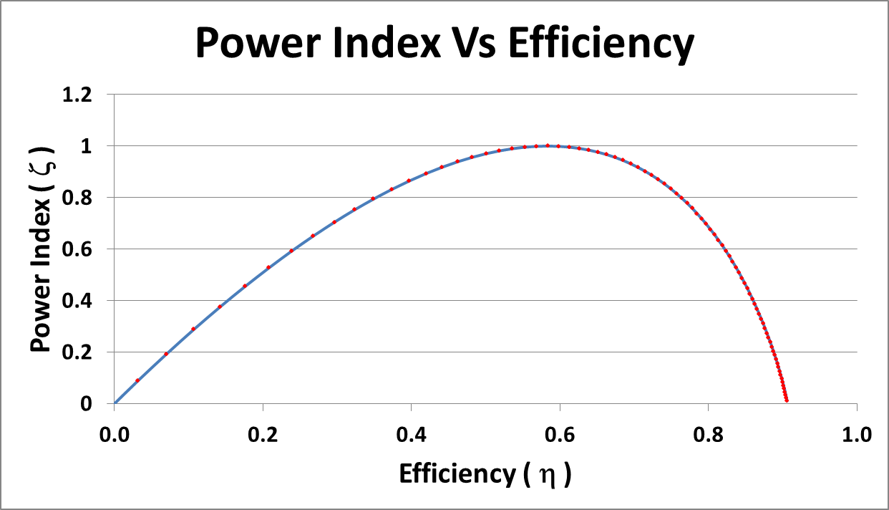
Maximum Power
Odum’s Insight of 1955
Maximum Power
Maximal Effectiveness
Optimal Efficiency
Maximum Efficiency
Power Index is defined as ξ(W) ≡ P_{B}(W) / max (P_{B}(W))
A34
Notes:
Lotka’s argument was demonstrated when the system-wide instantaneous value of R was shown to be one in the EffLab I model when the effects of the decomposers and detrivores was added. I want to pursue the insights of Odum. Here is a typical graph of a power index versus eta (Carnot’s efficiency). The great innovation of Odum and Pinkerton was the plot of power of the benefits versus Carnot’s efficiency for varying values of the micro-factor of production.
{CLICK}
As Carnot had argued, an efficiency of 1.0 cannot be achieved, and all practical graphs indicate a maximum attainable efficiency less than one. But Odum and Pinkerton argued that natural selection would not operate to maximize efficiency.
{CLICK}
They argued that natural selection would select those mechanisms that delivered the benefits at maximum power, and at some intermediate level of efficiency, that might be called optimal efficiency. A mechanism operating at maximum efficiency might take a very long time to deliver it. Maximum benefits per unit of time is a different matter.
{CLICK}

Slide 35
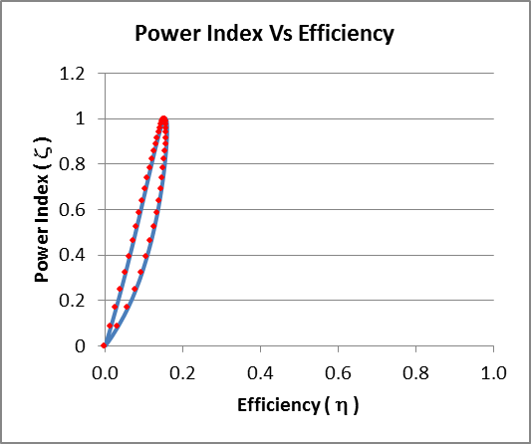
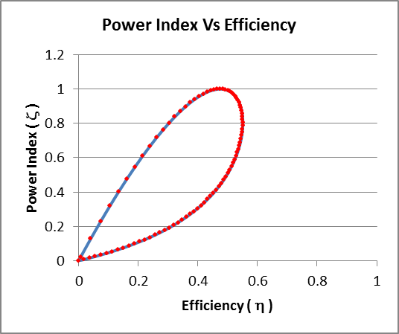
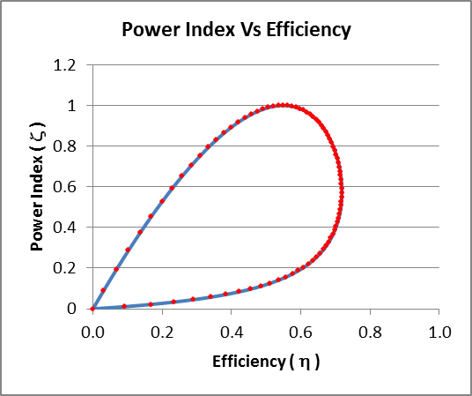
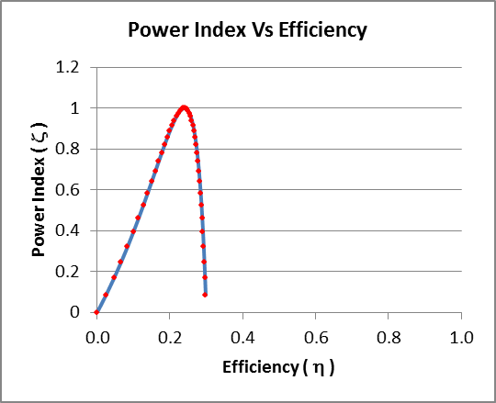
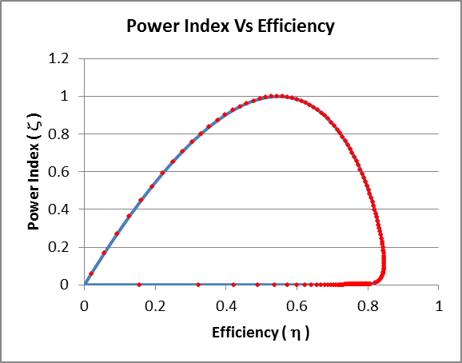
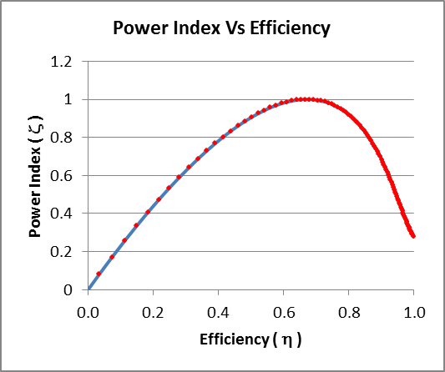
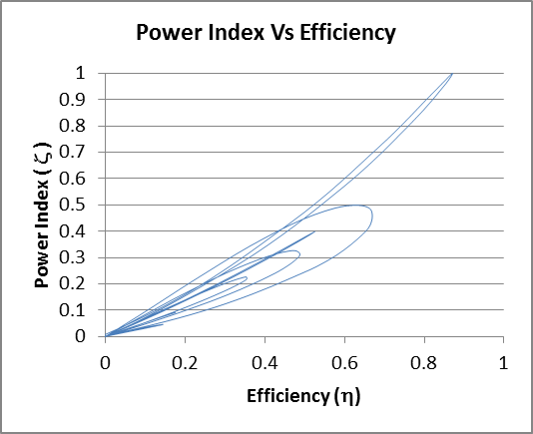
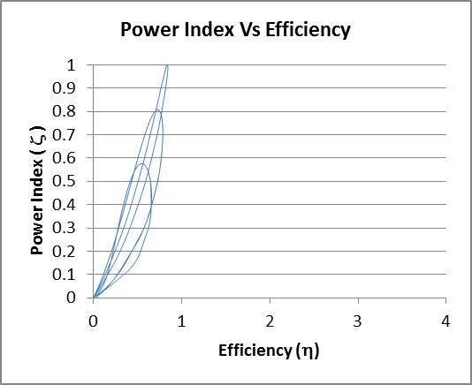
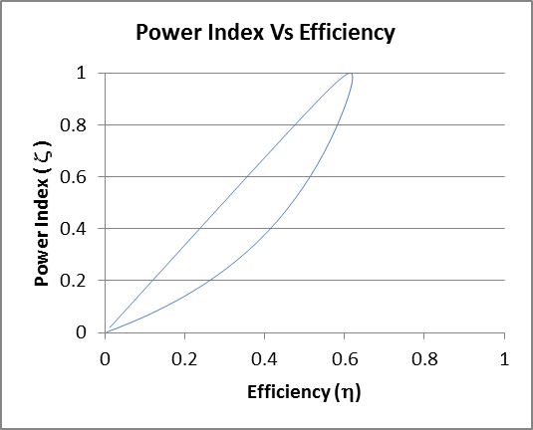
Gallery of Goldilocks Curves
(Scatter Graphs of P_{useful}(W) versus η(W))
Adapted from: 151224 NTF ICBT and PowEff R7.docx
A35
Notes:
The existence of such curves, that I am calling Goldilocks curves, is a tautological fact. If there is a profitable domain associated with an ICB curve set, then a Goldilocks curve exists. Here’s a small gallery of samples. Note that they tend to be loops, or loops with very flat bottoms such that they appear as humps. I like the curves in the bottom left corner. For those I make the costs a cyclic function of the number of workers, giving me many loops. They might represent the costs and benefits of building additional manufacturing plants, showing improved performance associated with fully operational plants. But all of these Goldilocks curves have the characteristic Odum looked for – that is – the power is maximized for some intermediate value of Carnot’s efficiency.
{Click}

Slide 36
Galbraith’s Theory of the Firm
(As explained by the MPP)
The neoclassical theory of the firm concludes that … firms attempt to maximize profits.
According to Galbraith:
  this may be true in the market sector, where owners of small firms actively manage their enterprises, but
  does not describe the far more important planning sector – the 2000 or so largest firms that produce over half of society's output.
The central protective purpose of the firm is survival:
  to earn a profit sufficient to keep most stockholders relatively happy, and
  to provide sufficient retained earning for investment and growth.
A
B
A38
Excerpted from: http://economistsview.typepad.com/economistsview/2006/04/john_kenneth_ga.html
Notes:
Can we find mention of any concept similar to this in economic theory? I think so. John Kenneth Galbraith was a heterodox and rather unconventional economist of the 1960s era. He tended to avoid mathematics, and so his arguments tended to be forgotten in a field dominated by sophisticated mathematical and computer-based models. In 1965 Galbraith argued that multi-national corporations had a different dynamic from smaller corporations.
Economic theory argued that small corporations work to maximize returns to investors through direct payments such as wages and dividends. This would correspond to the point on a Goldilocks curve for which maximum returns happen, no matter how long it takes to realize the return.
{CLICK}
However, he argued that the largest corporations responded differently. They provide the minimum flow of direct payments needed to keep investors happy, and divert the rest of the flow of retained iearnings towards growth and persistence. Such firms would be operating at maximum power, as per Odum’s definition of power of the benefits.
Let’s call the first group “Type A” firms, and the second group “Type B” firms.
{Click}

Slide 37
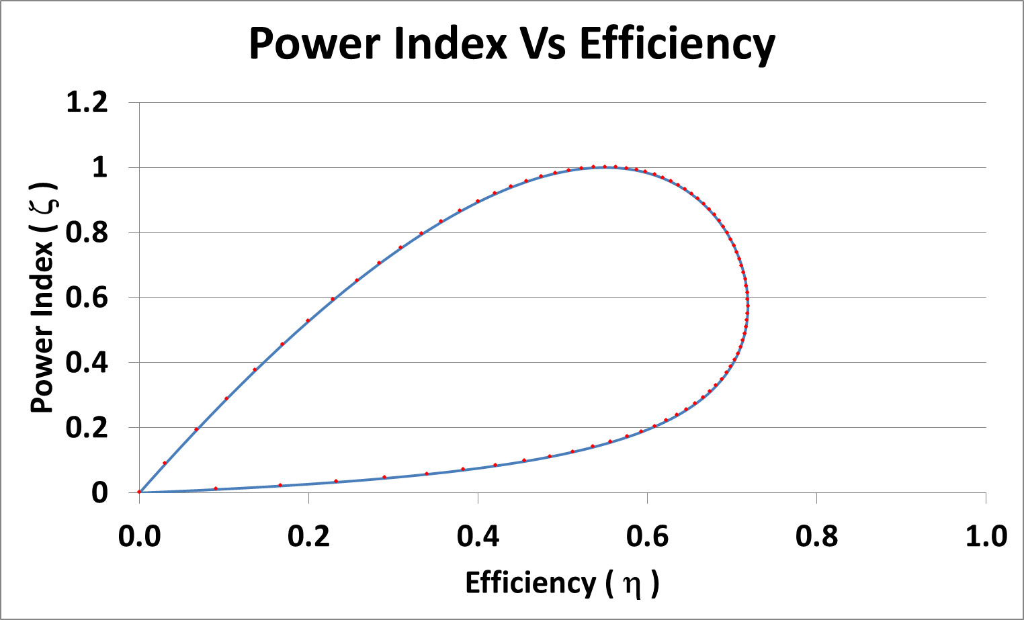
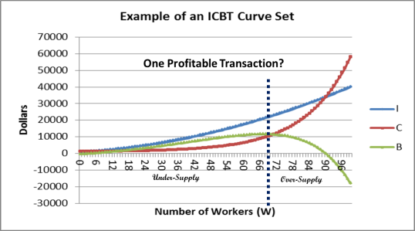
Galbraith’s Theory of the Firm
(As explained by the MPP)
B) Labour level with maximum flow of returned benefits (Max P_{B}(W), Optimum Efficiency)
Over-Supply
A) Maximum Profits
Under-Supply
A39
Notes:
Let’s put this in the context of a Goldilocks loop. Recall that one of these loops exists whenever there is a flow of benefits associated with a profitable activity associated with an MFP. For example, the red dots in the graph might represent staffing levels. And we are no longer talking about a flow of energy, but now a flow of benefits in the form of income – dollars – money.
{Click}
I hypothesize that the Type A firms would be operating at a staffing levels associated with maximum efficiency, creating a maximum direct return to shareholders on investments. This would include those firms operating in a mature saturated market offering common commodities at low cost. Profits would be harvested by the owners of small firms as wages, and by the shareholders of larger firms (sometimes referred to as “cash cows”) in the form of dividends and preferred shares. I think such businesses would not benefit from globalization.
{Click}
On the other hand, I hypothesize that the larger Type B firms would operate closer to the point of maximum power, diverting their retained earnings towards growth of share value, research and development, mergers and acquisitions, opening of new markets, and in general, persistence and growth of the firm. Such firms would compete on innovation of products, exploiting new technologies, and opening new markets. I think that such businesses would benefit from globalization.
{Click}

Slide 38
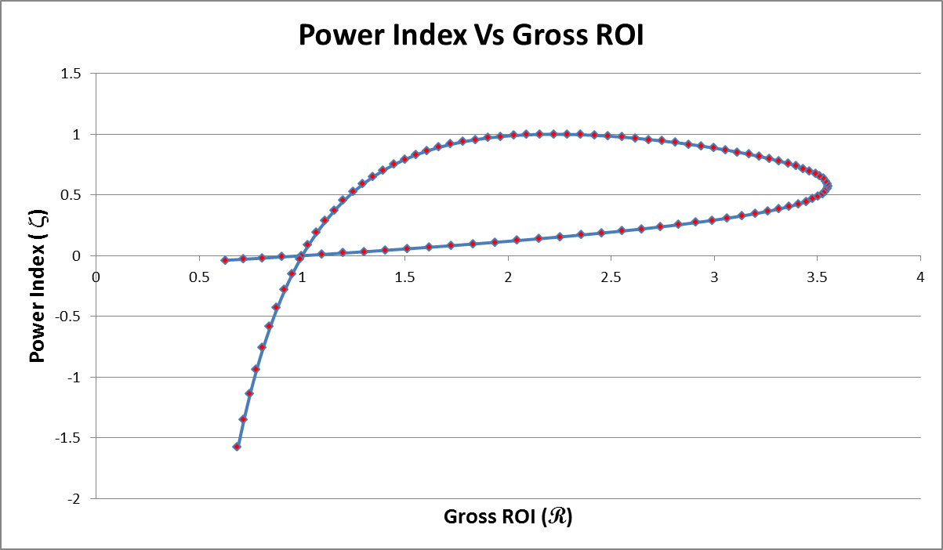
Profitable Domain
Multi-Headed Hydra
Ψ
Over-Supply
Dominance
Cash Cow
Unprofitable Domain
Under-Supply
R = 1
The independent variable may be either R or η.
Either way, a ‘Goldilocks’ loop results.
A41
Notes:
But, interesting, I have discovered that the same sort of ubiquitous Goldilocks curve emerges for both eta and R.
{CLICK}
When R is used as the independent variable, we get this Goldilocks curve.
{CLICK}
There is an unprofitable domain for which the MFP is either too low or too high. {CLICK} There is a profitable domain for which a firm can make some profits.
{CLICK}
There is a condition of under-supply of the MFP {CLICK}, over-supply of the MFP, or {CLICK} market dominance.
{CLICK}
There is room for ‘cash cows’, and {CLICK}, and multi-headed hydras.
{CLICK}

Slide 39
However!
Some hunts fail to capture prey!
Some investments have zero returns!
Some organisms die of starvation!
Some businesses fail due to bankruptcy!
Then can R have a value less than one?
What values does η take when R < 1?
A36
Notes:
However, there is a logical discrepancy associated with the use of Carnot’s efficiency in this context, and I am still in the process of trying to understand the nature of this discrepancy and its source. We know that not all organisms or organizations are persistent.
{CLICK}
Some hunts fail to capture prey.
{CLICK}
Some organisms die of starvation.
{CLICK}
Then sometimes R can have a value less than one, as we saw in the EffLab I model.
{CLICK}
So then the question arises, what values does Carnot’s efficiency eta take on when R is between zero and one?
{CLICK}

Slide 40
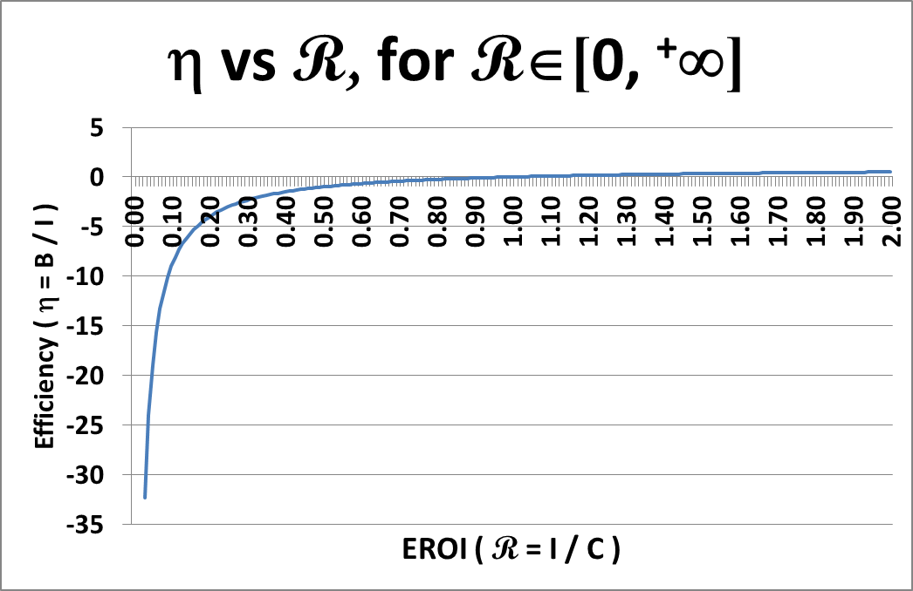


Extension of η into Negative Values
η = (1 – R) / R
Domain of R: R ∈ [0, ⁺∞]
If R ∈ [0, ⁺∞] , then η ∈ [–∞, 1]
A37
Notes:
Here’s the equation for conversion from R to eta.
{CLICK}
We can make a graph, with R as the independent variable and eta as the dependent variable.
{CLICK}
Then, as R approaches zero, the limit on eta is negative infinity.
{CLICK}
And as R approaches positive infinity, the limit on eta is one.
{CLICK}
This means that the domain of valid values for Carnot’s efficiency should be extended to cover the interval from negative infinity to one.
{CLICK}

Slide 41
However! (Again!)
Two Incompatible Paradigms
SIMPLE DECAY
Efficiency = η ≡ B / I
Useful residue of power in engineering studies
Radioactive decay
Depreciation of assets
Degrowth => R∈[0, 1]
By Definition
Degrowth => η∈[0, 1]
SIMPLE GROWTH
Gross ROI = EROI ≡ I / C
Discounted Cash Flows
Profitability of firms
Persistence of organisms
Growth => R∈[1,⁺∞]
By Logic
Degrowth => η∈[⁻∞, 0]
A42
Notes:
We have these two widely used paradigms for growth and decay of systems. They are used not just in science and engineering disciplines, but are also both used in some fashion in economic analyses. My problem is this – together they contain a logical inconsistency that cannot be easily addressed.
{CLICK}
By definition, eta was designed to address the problem of decay of capabilities as waste heat is produced. The natural domain for eta is the interval from zero to one.
{CLICK}
But when we use the conversion formulae to extend the domain of eta, we come to a logical inconsistency that needs to be examined. This inconsistency does not seem to cause problems until we examine iterated systems such as trophic chains (each link is an iteration) or daily harvest and growth (each transaction is an iteration). In particular, iterated systems that involve both growth and decay simultaneously expose a problem.
My approach was to examine each of the two paradigms in detail, and then attempt a merger. For each paradigm, I produce some recursive equations to address iterative application of the paradigm, and then convert such recursive equations into discrete-time equations.
{CLICK}

Slide 42


Simple Decay Paradigm – EXPLODED VIEW
Process – a recursive example:
t₀ – Initialization:
  Source of new energy input is not relevant
  I₀ = Exists as an internal asset
Energy Source
t_{n} – Decay Cycle:
  Calculate net return as B_{n-1} ≡ η_{n-1}I_{n-1}
  Degraded energy is C_{n-1} = I_{n-1}–B_{n-1}
  Internal asset is now I_{n} = B_{n-1}
C₀
I₁ = B₀
= η₀I₀
I₀
η₀
B₀
I₁
Energy Sink
CLASSIC IMPLIED SYSTEM BOUNDARY
t₀
t₁
A43
Notes:
So let’s start with the simple decay paradigm used for calculation of depreciation of assets, or decay of radioactive materials, or simple energy consumption of a hand tool. In this instance Carnot’s concept of efficiency is used. In this paradigm there is no external source of energy, as all of the energy being considered is already in existence within the system. We can remove the external source.
{CLICK}
In any recursive definition of a process, you must:
Define any givens, to be used in the iterations. Eta might be a constant for all iterations, but for the most general case, I should assume a series of values for eta designated as eta with a sub-script i.
Initialize one or several key variables
{CLICK}
Define the rules that take you from iteration to iteration, which usually consist of:
Some internal calculations within a step
{CLICK}
Combined with some bridging equations which access the variables from a previous iteration.
{CLICK}
Note that although it is rarely discussed when this computation is made, there is an implied system boundary that isolates a system from its sources and sinks. The only energy crossing the system boundary in this paradigm is the waste heat generated as the initial endowment of energy degrades.
{CLICK}

Slide 43

Simple Growth Paradigm – EXPLODED VIEW
Process – a recursive example:
t₀ – Initialization:
  Source exists as store of external assets
  I₀ = Exists as internal asset
t_{n} – Growth Cycle:
  Relabel I_{n-1} as investment “cost” C_{n}
  Expend as C_{n} as “investment”
  Calculate gross returns as I_{n} ≡ R_{n}C_{n}
  Calculate net return as B_{n} ≡ I_{n} - C_{n}
Returns Source
B₁
I₁ = R₁C₁
R₁
I₀
C₁
C₁
Investment Sink
CLASSIC IMPLIED SYSTEM BOUNDARY
t₀
t₁
A44
Notes:
The simple growth paradigm, which encompasses the EROI calculation, is a little more complicated because both a source and a sink are involved. The givens again will be a series of values R with a subscript of I representing the gross return expected at each iteration.
{CLICK}
Again, we initialize the system.
{CLICK}
There are equations used for calculating variables within each iteration.
{CLICK}
There is at least one bridging equation that connects this iteration to previous value.
{CLICK}
When we note the system boundary, we note that the sink into which investments are made, and the source out of which returns are expected, are both outside of the system boundaries. These are the ‘externalities’ of the economic paradigm.
{CLICK}

Slide 44
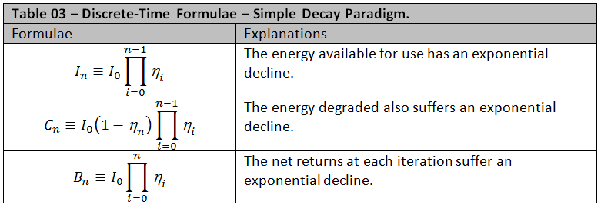
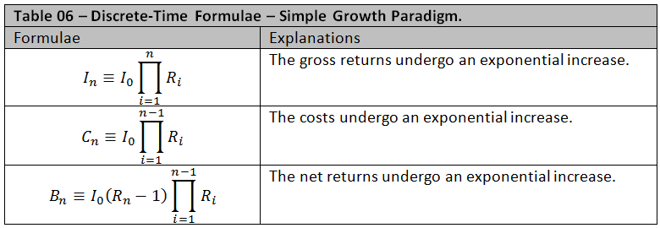
Comparing the Two Paradigms
Adapted from: 170518 NTF On Efficiency and Growth R3.docx
A45
Notes:
Once the, recursive equations are developed, one can then convert them to discrete-time formulae. The benefit is that one usually need not complete calculations for, say, 100 iterations, but can simply calculate the answer for the 100th iteration directly. Here we see the discrete-time formulae for each of the two paradigms. They are very similar, but not the same.
{CLICK}
The most obvious difference is the use of eta in the decay paradigm and the use of R in the growth paradigm.
{CLICK}
But you will also notice that the top parameters are different.
{CLICK}
The bottom parameters are different.
{CLICK}
And the associated factors are similar but not the same. You might imagine that one set of formulae can be readily converted to the other, say, by simply converting each eta to an R and re-arranging, but that is not true. It seems that the two sets of formula are utterly different in some fundamental way.
{CLICK}

Slide 45
Metabolic Growth Paradigm – EXPLODED VIEW
η&R
Process – a recursive example:
t₀ – Initialization:
  I₀ = Exists as internal asset
  Source exists as store of external assets
Energy Source
t_{n} – Growth Cycle:
  Unavoidably expend δ_{n} while waiting for investment opportunity
  Expend as C_{n} = (I_{n-1}–δ_{n}) as “discretionary investment”
  Calculate gross returns as I_{n} ≡ R_{n}C_{n}
  Calculate net return as B_{n} ≡ I_{n} - C_{n}
η₁ = (I₀-δ₁)/ I₀
δ₁
B₁
I₀
η₁
I₁ = R₁C₁
R₁
C₁
C₁
C₁
Heat Sink
IMPLIED SYSTEM BOUNDARY
t₀
t₁
A47
Notes:
Having failed to merge these two paradigms, but reasoning that both paradigms are active continuously as an organism lives and grows, I sought to mingle them. In this view I am considering what I call the ‘metabolic growth paradigm’ in which an organism experiences an ongoing mandatory expense of energy due to metabolic homeostasis, but can make discretionary expenses, (i.e. discretionary investments) in order to capture prey, diverting some of that captured energy towards growth and reproduction. This would correspond to the economic concepts of non-discretionary operations and maintenance expenses, and discretionary capital investments.
Note that this time we have one flow from the source, and two types of flows into the sink. For reasons too complex to get into in this brief presentation, I decided to replace Carnot’s efficiency factor eta with an absolute measure of the flow delta.
{CLICK}
Again, we have initialization of the system with an energy endowment;
{CLICK}
Some recursive equations used to calculate new variables; and
{CLICK}
Some bridging variables.
{CLICK}
And, once again, note that there is an implied system boundary through which the flows penetrate, drawing from and dumping into the external environment.
{CLICK}

Slide 46
η&R
METABOLIC GROWTH PARADIGM
DISCRETE-TIME
THREE RECURSIVE STEPS – EXPLODED VIEW
Energy Source
I₃ = R₁C₃
= C₃ + B₃
I₂ = R₂C₂
= C₂ + B₂
η₃ = (I₂-δ₃)/ I₂
I₁ = R₁C₁
= C₁ + B₁
C₃ = I₂ - δ₃
η₂ = (I₁-δ₂)/ I₁
B₃
η₁ = (I₀-δ₁)/ I₀
C₂ = I₁ - δ₂
C₁ = I₀ - δ₁
δ₃
INDIVIDUAL’S SYSTEM BOUNDARY
I₀
B₂
B₁
δ₂
δ₁
C₃
R3
η₃
C₃
I₀
η₁
R₁
η₂
R₂
C₃
C₁
C₁
C₁
C₂
C₂
C₂
HEAT SINK
t₀
t₁
t₂
t₃
Otto and Day (2008) “A Biologists Guide to Mathematical Modelling In Ecology and Evolution”, Princeton University Press.
ANALOGOUS TO: Page 80 – Equation 3.20c – Continuous-time equation for growth with harvesting.
A48
Notes:
To convert that rather complicated model of the metabolic growth paradigm into a set of discrete-time equations one needs to take a longer view. Here there are three complete iterations of the metabolic growth paradigm.
{CLICK}

Slide 47
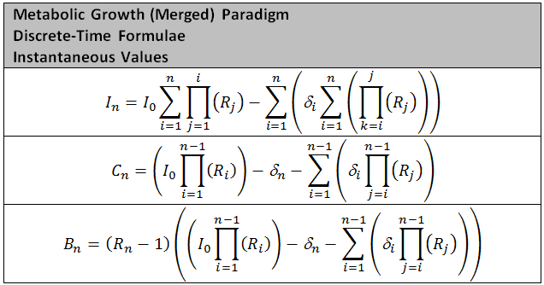
Metabolic Growth Paradigm
LEGEND: t_{n} = time step n; I = income; C = discretionary investments; B = benefits; R = gross ROI; δ = loss due to unavoidable metabolic expenditures; i, j, k & n = enumerative variables.
GIVENS: I₀ = initial endowment; R_{i} = stream of actual gross ROI based on investment costs; δ_{i} = stream of actual metabolic expenditures.
A49
Notes:
I produced two sets of equations for I, C and B. Here we have the instantaneous values. Now I am reasonably certain that these equations faithfully describe the metabolic growth paradigm. With these equations I can reproduce all of the many various trajectories of growth and decay. However, I am absolutely certain that they are extremely difficult to work with, and so are not very useful.
{CLICK}

Slide 48
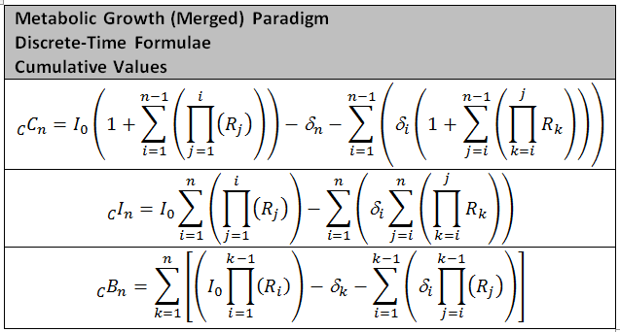
Metabolic Growth Paradigm
LEGEND: t_{n} = time step n; I = income; C = discretionary investments; B = benefits; R = gross ROI; δ = loss due to unavoidable metabolic expenditures; i, j, k & n = enumerative variables.
GIVENS: I₀ = initial endowment; R_{i} = stream of actual gross ROI based on investment costs; δ_{i} = stream of actual metabolic expenditures.
A50
Notes:
And here we have the cumulative formulae. These are the cumulative discrete-time- formulae, being somewhat similar in appearance to the instantaneous discrete-time formulae, but representing the sum of all previous iterations to the present.
Again, these are extremely difficult to work with, and so, not very useful.
{CLICK}

Slide 49

Growth/Decay Models – System Boundaries
Metabolic Growth Model
NYSE Growth Model
Simple Growth Model
Simple Decay Model
I_{n} in
I_{n} in
I_{n} in
I_{n}
I_{n}
I_{n}
I_{n}
C_{n} out
C_{n} out
δ_{n} out
C_{n} out
INDIVIDUAL’S SYSTEM BOUNDARY
Contextualized Metabolic Growth Model
System Inputs
δ_{n} out
System Outputs
Resource Sources
I_{n} in
I_{n}
Resource Sinks
C_{n} out
PROPPER SYSTEM BOUNDARY
Feedback
Channels
Recycle Channels
The Biosphere’s Boundary
A51
Notes:
In summary we seem to have several growth/decay models that contain within their classic formulation a logical discrepancy that I have so far failed to overcome effectively. Nevertheless, in spite of that failure, we see that nature has quite easily learned to overcome it. The simple decay model has one flow out into the environment, and is explicated using Carnot’s efficiency factor eta.
{CLICK}
I have not discussed the NYSE growth model, but it can be drawn as a system with one flow inwards from the environment.
{CLICK}
The simple growth paradigm has one flow in and one flow out, and is explicated using Hall’s efficiency factor EROI.
{CLICK}
The simple decay paradigm and the simple growth paradigm are merged in nature in the form of the metabolic growth paradigm. Unfortunately, my attempts to merge Carnot’s eta and Hall’s EROI mathematically founder on the logical inconsistencies, as previously described. However, the field of study that we call biophysical economics must take a wider view. The system boundary should not be the scope of interest of the growing organism or organization, but should include the entire biosphere. It must include all of those sources and sinks that are currently considered ‘externalities’ by NCE. {CLICK} In the bottom diagram you see the metabolic growth paradigm {CLICK} embedded in the larger biosphere. And, and organism is not alone. If you look carefully, {CLICK} all of the other organisms and economic organizations are also embedded within the biosphere. {CLICK}

Slide 50
OVER-ARCHING ROLES OF CONSERVATION, SIMPLE DECAY AND POINT-OF-USE
Contextualized Metabolic Growth Model
System Inputs
δ_{n} out
System Outputs
Resource Sources
I_{n} in
I_{n}
Resource Sinks
C_{n} out
Energy Source
Energy Sink
Feedback
Channels
Recycle Channels
The Biosphere’s Boundary
A51a
Notes:
But, I think my model of the contextualized growth paradigm needs one more important addition. There are serious constraints on growth and decay.
{CLICK}
Conservation effects and the effects of rising entropy provide an over-arching set of constraints on both growth and decay.
{CLICK}

Slide 51

My Recommended Source-Book for Economic Modeling
(2008) Princeton University Press
Scope of My Mathematical Explorations Re EROI:
Define MFPs
Define ICBT Curve Sets
Define η, R and N
Extend domain of η
Explore Galbraith & R
Identify Two Paradigms
Merge Two Paradigms
Examine implied system boundaries
A52
Notes:
This is a summary of my mathematical explorations of EROI, as presented above.
{CLICK}

Slide 52
The End
Questions?
A53

Slide 53
Hip Pocket Slides
A54

Slide 54

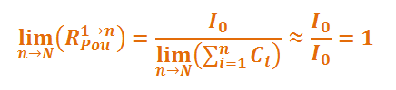
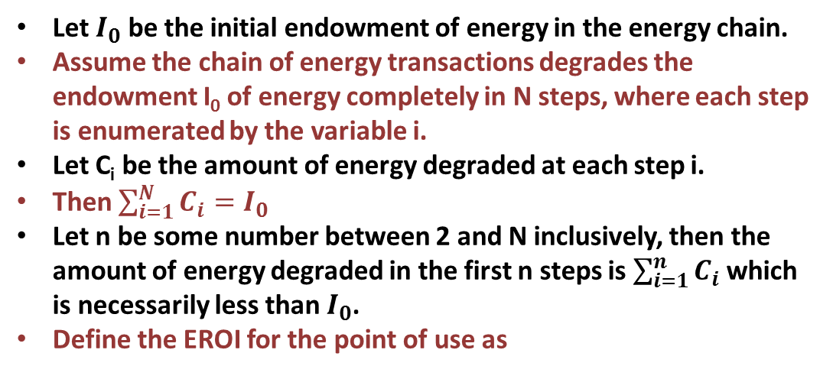
Efficiency Laboratory #I
Point Of Use (POU) Issues
R_{POU}
Let $I_{0}$ be the initial endowment of energy in the energy chain.
Assume the chain of energy transactions degrades the endowment I₀ of energy completely in N steps, where each step is enumerated by the variable i.
Let C_{i} be the amount of energy degraded at each step i.
Then $\sum_{i=1}^{N}{C_{i}=I_{0}}$
Let n be some number between 2 and N inclusively, then the amount of energy degraded in the first n steps is $\sum_{i=1}^{n}{C_{i}}$ which is necessarily less than $I_{0}$.
Define the EROI for the point of use as
A55
Notes:
Point of use calculations for EROI are a peculiar mix of the growth and decay paradigms. Essentially, we are using Hall’s efficiency measure EROI, a growth-based formula, to describe the mandatory decay of the potency of energy as it passes down through a consumptive chain of transformations. The mathematics for such a hybrid concept is markedly different from either of the basic growth and/or decay paradigms, and perhaps there is some insight to be found in further examination of this approach.
{CLICK}

Slide 55
Point-Of-Use Decay Paradigm – EXPLODED VIEW
η_{POU}
Process – a recursive example:
t₀ – Initialization:
  Source of new energy input is not relevant
  I₀ = Exists as an internal asset
Energy Source
t_{n} – Decay Cycle:
  Calculate net return as B_{n-1} ≡ η_{n-1}I_{n-1}
  Degraded energy is C_{n-1} = I_{n-1}–B_{n-1}
  Internal asset is now I_{n} = B_{n-1}
B₀ = η₀ I₀
C₀ = I₀ - B₀
η₀ = Given
I₁ = B₀
I₀
B₀
I₁
η₀
I₀
C₀
CLASSIC IMPLIED SYSTEM BOUNDARY
Energy Sink
A56
t₀
t₁
Notes:
Since Point-Of-Use is fundamentally a decay issue, I have examined the use of Carnot’s efficiency measure eta in the context of point-of-use formulae. As a decay paradigm, the flow from source is zero.
{CLICK}
We must initialize the endowment.
{CLICK}
There are recursive equations within an iteration {CLICK} and bridging between iterations.
{CLICK}
And there is an implied system boundary.
{CLICK}
But, all of this is happening in the context of the production of entropy of some sort as a conserved quantity is passed along through a supply chain of some sort.
{CLICK}
In other words, it is happening in the context of the second frame of the overview diagram.
{CLICK}

Slide 56
η_{POU}
POINT-OF-USE DECAY PARADIGM
DISCRETE-TIME
SIX RECURSIVE STEPS – EXPLODED VIEW
Energy Source
I₅ = B₅
I₆= B₆
I₃ = B₃
I₄ = B₄
η₅ = B₅/ I₄
η₆ = B₆/ I₅
E₀
I₁ = B₁
I₂ = B₂
η₃ = B₃/ I₂
η₄ = B₄/ I₃
B₅ = I₄ – C₅
B₆ = I₅ – C₆
η₁ = B₁/ E₀
η₂ = B₂/ I₁
B₃ = I₂ – C₃
B₄ = I₃ – C₄
B₁ = E₀ - C₁
B₂ = I₁ – C₂
B₆
η₆
I₆
B₅
η₅
I₅
C₆
B₃
B₄
I₄
I₃
η₄
B₂
I₂
η₃
C₅
I₁
B₁
η₂
C₄
PROCESS SYSTEM BOUNDARY
E₀
C₃
η₁
C₂
C₁
ZERO
OR
DECOMP & DETRIVORES
OR
FOSSIL FUELS
HEAT SINK
t₀
t₁
t₂
t₃
t₄
t₅
t₆
A56a
Notes:
When we extend the recursive diagram to include six iterations to a final point-of-use, the diagram looks like this.
There is no flow from source.
{CLICK}
The final amount of useful energy of a system-wide consumptive process has three possible values, depending on the disposition of the final products:
{CLICK}
It will be zero; or
The remnant will be expended by the action of decomposers and detrivores; or
The remnant will fall out of the range of the capabilities of current organisms to extract and exploit it, by, say, sinking to the bottom of an ocean, or being layered deeply in an oxygen-poor environment. Deposits of fossil fuels are accumulated by such mechanisms. Ultimately some organism (such as mankind) will evolve to have the ability to extract and exploit such energy, and the system-wide delivery of energy will be zero.
{CLICK}
The implied system boundary must not be forgotten, as there is a flow to an external sink.
{CLICK}

Slide 57





Efficiency Laboratory #I
Point Of Use (POU) Issues
R_{POU}
Let $I_{0}$ be the initial endowment of energy in the energy chain.
Assume the chain of energy transactions degrades the endowment I₀ of energy completely in N steps, where each step is enumerated by the variable i.
Let η_{i} be the Carnot-style efficiency at each step i.
Define η_{pou} for the point of use as
⇒
⇒
A57
Notes:
In the context of the 2nd law, it is possible to relate R and eta by considering the limits as the point-of-use approaches the ultimate end of the system-wide chain.
For example, if we define the point-of-use eta for a chain from step 1 to some intermediate step n like this
{CLICK}
Then we can also define the point-of-use R for the same portion of a chain using the conversion formula.
{CLICK}
This definition is certainly consistent with our concept of the relationship between these two measures of efficiency, since the limits as n approaches the ultimate point-of-use is in agreement with the demonstrated behaviour as seen in EffLab.
{CLICK}
As n approaches the end of the chain, eta POU approaches zero, and R POU approaches 1, as expected and required.
{CLICK}

Slide 58

Efficiency Laboratory #I
Syswide Experiment
R_{sys}
6400 CC doubled
3200 CC halved
1600 DnD turned on
A58
Notes:
This graph shows the carrying capacity (denoted as CC, the red line), and the population (the green line) as several changes were made.
At 1600 ticks, the activity of decomposers and detrivores was turned on.
At 3200 ticks, the carrying capacity was halved.
At 6400 ticks, the carrying capacity was restored to original value.
The carrying capacity is derivative, and not a hard parameter, so you can see that the system as-a-whole has a relaxation time of about 3200 ticks, and the carrying capacity oscillates briefly about its ultimate stationary-state value before such transient behaviour subsides.
Now, let’s see how the other aspects of the system respond to such cataclysmic changes in carrying capacity.
{CLICK}

Slide 59




Efficiency Laboratory #I
Syswide Experiment
R_{sys}
1600 DnD turned on
3200 CC halved
6400 CC doubled
TOP: Population and Carrying Capacity BOTTOM: Causes of Death
A59
Notes:
The top graph you have seen before.
The bottom graph has been aligned so that the cataclysmic events line up. It shows counts of deaths by reproduction (blue), by hunger (green) and by old age (red).
The introduction of the work of decomposers and detrivores had no effect on mode of death.
When the carrying capacity was halved, there was a surge of death by hunger, followed by a surge of death by old age, then fission, then hunger, then old age again.
When the carrying capacity was doubled, there was a prolonged double baby-boom, but when the population exceeded the carrying capacity, waves of death by hunger and old age followed before another surge of reproduction was exhibited.
{CLICK}

Slide 60

Efficiency Laboratory #I
Sys-wide Experiment
R_{sys}
1600 DnD turned on
6400 CC doubled
3200 CC halved
Impact on System-Wide EROI and Individual EROI (Min, Mean, Max)
A60
Notes:
Again, the cataclysmic events have been marked.
This graph shows instantaneous R for the seekers (maximum value (red), average value (green) and minimum value (blue). It also displays the system-as-a-whole value of R (purple). There is a black line marking where R = 1.
It is difficult to see in this graph, but when the decomposers and detrivores are turned on at tick 1600, the system-wide value of R, which was hovering just above 1, falls to fluctuate around the value 1.
When the carrying capacity is halved, the response of R_{sys} is more dramatic, oscillating wildly around the value of 1 until transient behaviour of the system subsides.
When the carrying capacity is doubled again, the response is similar but opposite in direction, immediately rising far above 1, then falling and oscillating about 1 until transient behaviour subsides.
{CLICK}

