Slide 1

Corruption and the Shadow of the Future
A Generalization of an ABM with Repeated Interactions
Nick van Doormaal
Stijn Ruiter
Andrew M. Lemieux

Slide 2
Corruption & Deterrence
Interaction between
two persons or groups
Deterred if perceived
risks or costs are too high

Slide 3
Corruption & Deterrence
Severity, Celerity, Certainty
Specific & General Deterrence

Slide 4
Modelling Corruption and Deterrence
Agent-based models
Study by Hammond (2000)
“Fear of enforcement”

Slide 5
Modelling Corruption and Deterrence
High
Low

Slide 6
Improving
Corruption Research
One-shot interactions:
  Declare taxes
  Apply visa
Cooperation through repeated interactions:
  Supplier – purchasing agent
  Police officers manipulating evidence

Slide 7
Model goal
Generalization of
Hammond’s model
Effect of repeated interactions
on general deterrence

Slide 8
Create agent population
Agent characteristics:
Honesty
Memory
Network
Suspended

Slide 9
Decision-making
Choose random player
Compare actions
Enforce
Decision-making
  x = Corruption payoff
  y = Honesty payoff
 |  | Player 2
 |  | Corrupt | Non-Corrupt
Player 1 | Corrupt | x, x | y, y
 | Non-Corrupt | y, y | y, y

Slide 10
Decision-making
Choose random player
Compare actions
Enforce
Decision-making
  x = Corruption payoff
  y = Honesty payoff
  Perceived payoff for corruption:
  x(1 - honesty)
  Example
    Honesty = 0.85 and x = 20
    Perceived payoff = 3

Slide 11
Decision-making
Choose random player
Compare actions
Enforce
Decision-making
Perceived payoff for corruption
Probability of other agent corrupt
Probability of getting caught
Duration of suspension term
Chooses corrupt if
weighted payoff > honest payoff

Slide 12
Decision-making
Choose random player
Compare actions
Enforce
Choose random
player
In a random order,
every non-suspended agent randomly select another agent who:
    has no partner
    is not suspended

Slide 13
Decision-making
Choose random player
Compare actions
Enforce
Compare actions
Possible outcomes
Honest
Both players acted honest
Mismatch
Corrupt and honest agent
Honest agent reports corrupt
Corruption
Both players acted corrupt

Slide 14
Decision-making
Choose random player
Compare actions
Enforce
Enforcement
Honest agent reports corrupt agent
Agent is suspended if reports exceeds a threshold
Agents don’t know the number of received reports

Slide 15
Base model
Decision-making
Choose random player
Compare actions
Enforce

Slide 16
Generalization
Number of interactions
  Values: 1, 2, 4, 6, 8
Weight to most recent value in memory
  Probability encounter corrupt agent
  Values: 0, 50, 100

Slide 17
Decision-making
Choose random player
Compare actions
Enforce
Decision-making
Perceived payoff for corruption
Probability of other agent corrupt
Probability of getting caught
Duration of suspension term
Chooses corrupt if
weighted payoff > honest payoff

Slide 18
Measurements
For every moment during the run:
  Honest agents
  Corrupt agents
Time when honest = corrupt
150 runs per scenario

Slide 19
Model settings
Agent population = 300
Corruption payoff = 20
Honest payoff = 1
Memory = 5
Network = 10
Reports required = 2
Suspension term = 4

Slide 20
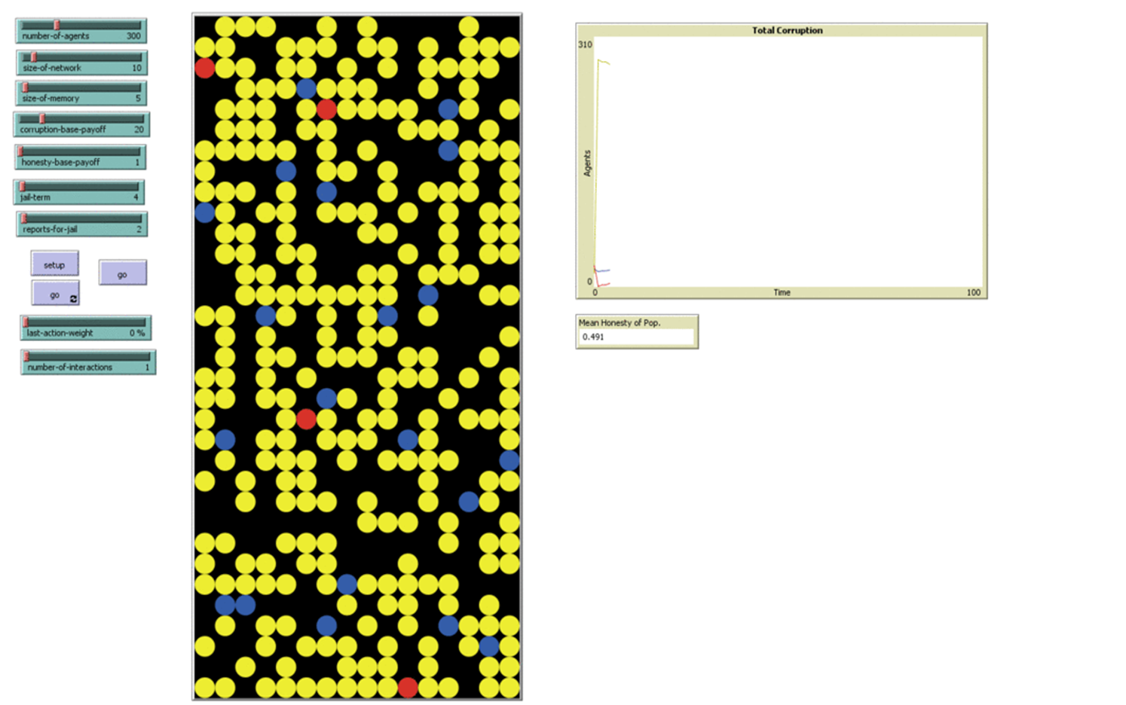
Example run

Slide 21
Results
Number of corrupt agents
  at end of simulation run

Slide 22
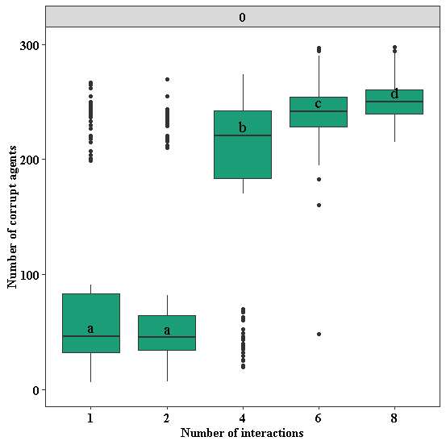
Interactions

Slide 23
Results
Number of corrupt agents
  at end of simulation run
For different weights

Slide 24
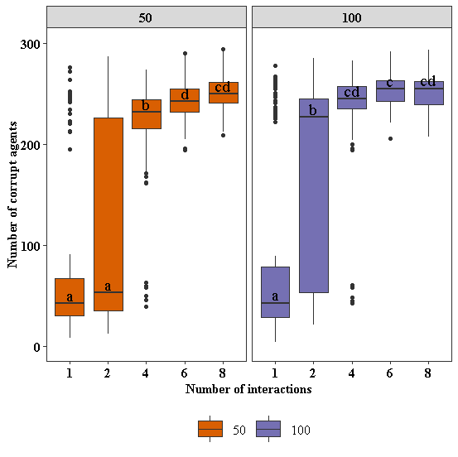
Weights
50 weight 100 weight

Slide 25
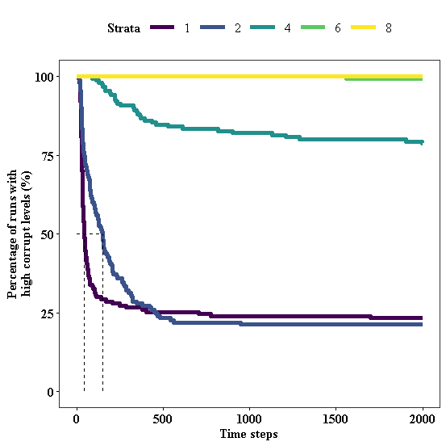
Transitions
Interactions

Slide 26
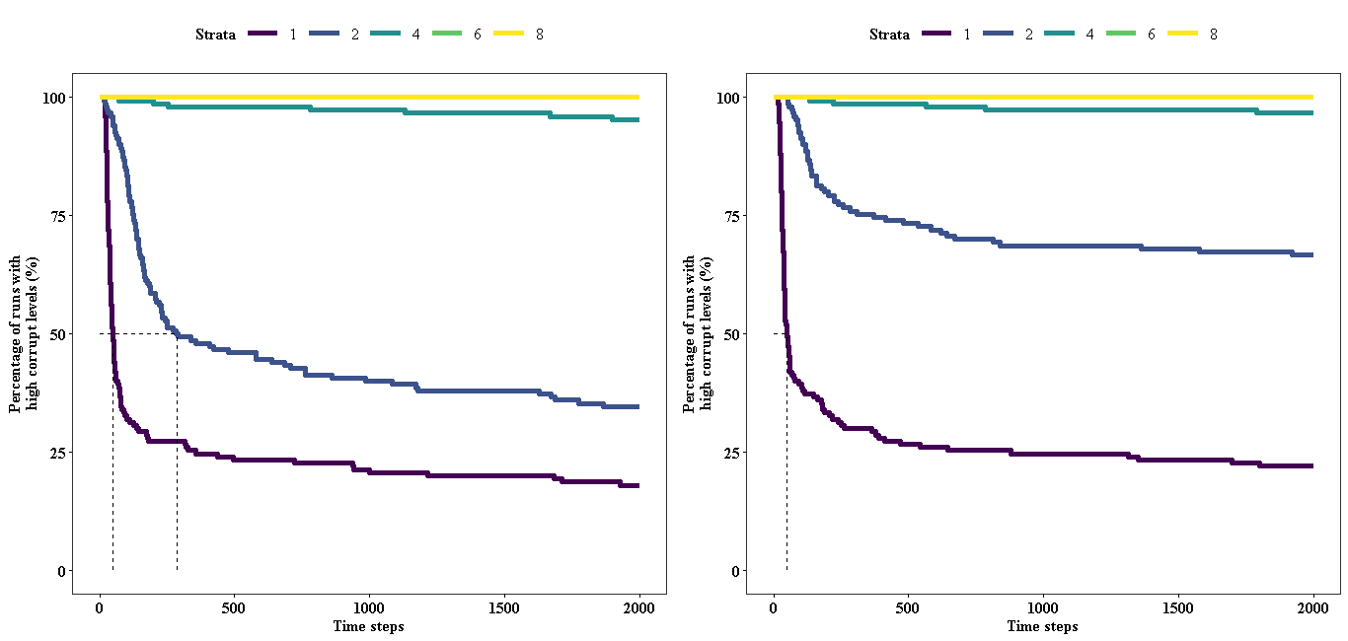
Transitions - Weights
50 weight 100 weight

Slide 27
Results summary
Repeated interactions:
delayed and fewer transitions
Weak effect of weights

Slide 28
Discussion
General deterrence
Corruption removes certainty
One-shot interactions
  Staff rotation

Slide 29
Discussion
Limitations
Perceived severity?
Stylized facts?

Slide 30
Corruption and the Shadow of the Future
A Generalization of an ABM with Repeated Interactions
Thank you for your attention!
Questions?

