Slide 1
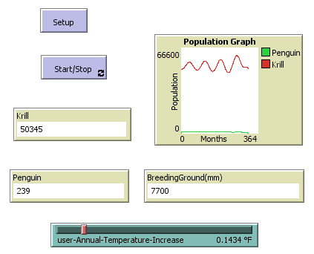
Effect of Climate Change on Adélie Penguin and Krill Population
By: Eric Liu

Slide 2
Access the Model Online
http://modelingcommons.org/browse/one_model/6660#model_tabs_browse_files

Slide 3
Background
How will increasing global temperatures affect Antarctic ecosystems? In this exercise, we will study the effect of increasing global temperatures on Adélie Penguin and Krill (predator and prey) population. One of the primary reasons for population decline in Antarctic species is habitat loss. Higher global temperatures melt through the Antarctic ice sheets that once served as the habitat and breeding grounds of millions of Adélie Penguins and Krill.
In this model, we will be using two specific resources:
The IMBIE team., Shepherd, A., Ivins, E. et al. Mass balance of the Antarctic Ice Sheet from 1992 to 2017. Nature 558, 219–222 (2018). https://doi.org/10.1038/s41586-018-0179-y
Data collected by NASA’s Goddard Institute for Space Studies (GISS)
The first is a research study on the total loss of Antarctic Ice Sheets from 1992 to 2017 and the second is data provided by NASA on the yearly global temperature average from 1880 to now.
Read the research study if you would like additional background for creating the model, however, reading the research study is not necessary. The results of the study are posted on the IMBIE team website where all recorded data can be accessed.

Slide 4
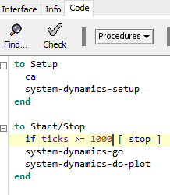
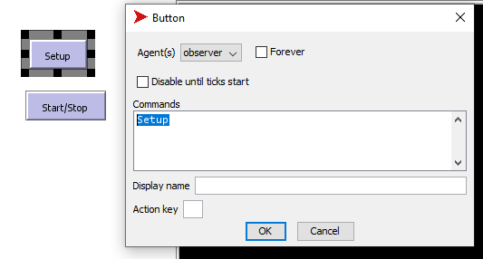
Building the Model
We will be using NetLogo to build this model. To learn more about NetLogo, click on this guide. Once you have launched NetLogo, click on the Code tab and copy the following lines:
Go back to the Interface tab. You will see an error saying SYSTEM-DYNAMICS-SETUP has not been defined. To fix this, go into the Tools tab and select System Dynamics Modeler. Most of our work will be done in this tool. After launching the System Dynamics Modeler, the error should eventually go away.
We will be creating two buttons called Setup and Start/Stop that will serve as entry points for our model. Upon clicking the two buttons, the code pasted earlier will run. We want to stop the program after 1000 ticks have run. In this model, every tick represents one month. Create the Setup and Start/Stop buttons by selecting Button and clicking on the Add symbol in the Interface tab. Click anywhere within the window to create the button. Right click the button to begin editing it. Set Agent(s) to Observer and type Setup in Commands. Create the Start/Stop button in a similar fashion. Check the Forever box for the Start/Stop button only.

Slide 5
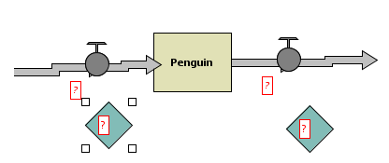
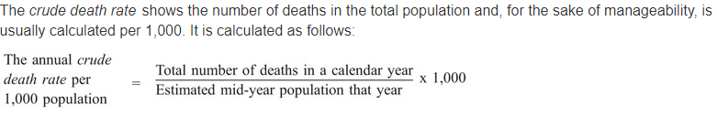
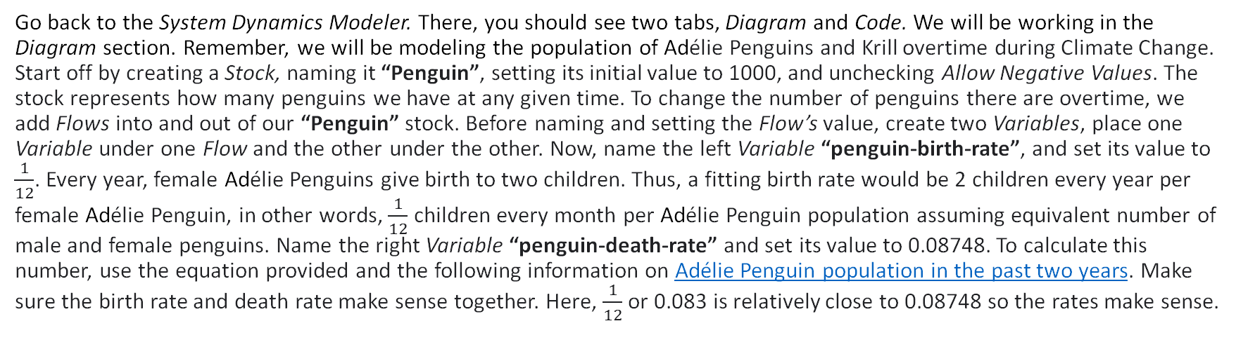
Building the Model
Go back to the System Dynamics Modeler. There, you should see two tabs, Diagram and Code. We will be working in the Diagram section. Remember, we will be modeling the population of Adélie Penguins and Krill overtime during Climate Change. Start off by creating a Stock, naming it “Penguin”, setting its initial value to 1000, and unchecking Allow Negative Values. The stock represents how many penguins we have at any given time. To change the number of penguins there are overtime, we add Flows into and out of our “Penguin” stock. Before naming and setting the Flow’s value, create two Variables, place one Variable under one Flow and the other under the other. Now, name the left Variable “penguin-birth-rate”, and set its value to $\frac{1}{12}$. Every year, female Adélie Penguins give birth to two children. Thus, a fitting birth rate would be 2 children every year per female Adélie Penguin, in other words, $\frac{1}{12}$ children every month per Adélie Penguin population assuming equivalent number of male and female penguins. Name the right Variable “penguin-death-rate” and set its value to 0.08748. To calculate this number, use the equation provided and the following information on Adélie Penguin population in the past two years. Make sure the birth rate and death rate make sense together. Here, $\frac{1}{12}$ or 0.083 is relatively close to 0.08748 so the rates make sense.

Slide 6
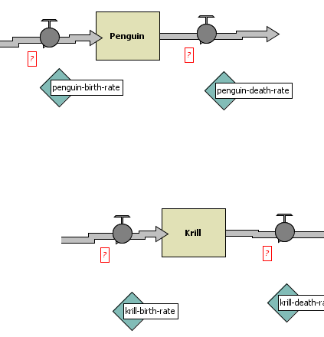
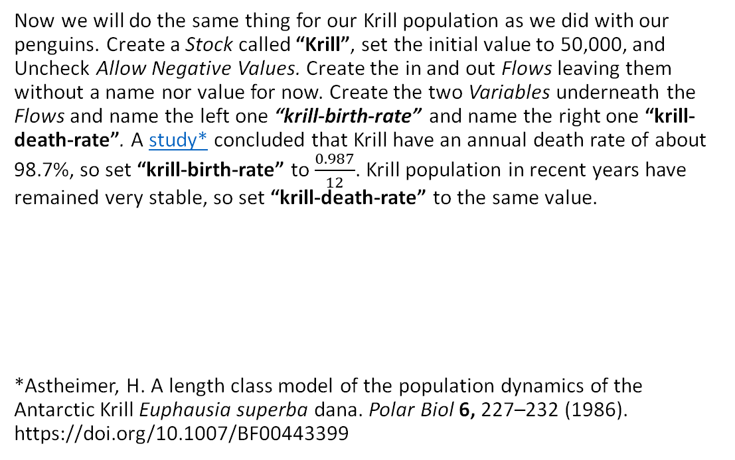
Building the Model
Now we will do the same thing for our Krill population as we did with our penguins. Create a Stock called “Krill”, set the initial value to 50,000, and Uncheck Allow Negative Values. Create the in and out Flows leaving them without a name nor value for now. Create the two Variables underneath the Flows and name the left one “krill-birth-rate” and name the right one “krill-death-rate”. A study* concluded that Krill have an annual death rate of about 98.7%, so set “krill-birth-rate” to $\frac{0.987}{12}$. Krill population in recent years have remained very stable, so set “krill-death-rate” to the same value.
*Astheimer, H. A length class model of the population dynamics of the Antarctic Krill Euphausia superba dana. Polar Biol 6, 227–232 (1986). https://doi.org/10.1007/BF00443399

Slide 7
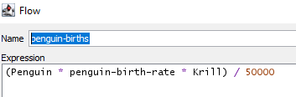
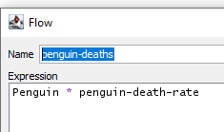
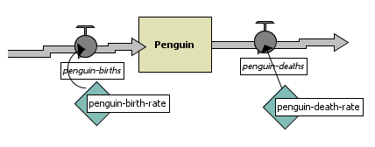
Building the Model
Now we will start adding values and names for our Flows. Name the Flow left of the penguin stock “penguin-births” and the right “penguin-deaths”. These will be our expressions.
“penguin-births” is dependent on three factors: number of penguins (“Penguin” stock), penguin birth rate, and number of krill. Number of krill is also a variable as it more krill equates to more food for the penguins. Make sure to divide the number by the initial Stock of “Krill” (in this case, 50,000). This will ensure that the number of penguins born at any time is not excessive. Click on Link and drag an arrow from “penguin-birth-rate” to “penguin-births” and “penguin-death-rate” to “penguin-deaths”. Be sure to always Link variables when they are used in an expression.

Slide 8
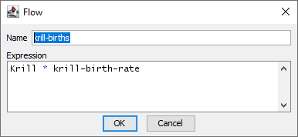
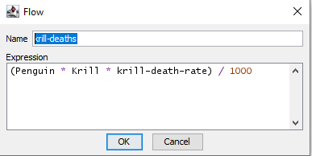
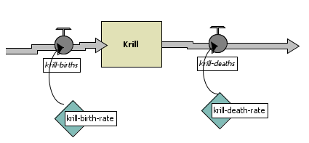
Building the Model
Do the same process for Krill.
“krill-deaths” similarly is dependent on the number of penguins there are. The more penguins there are, the more krill will get eaten and die. Remember to offset the expression by dividing by the initial Stock of “Penguin”.

Slide 9
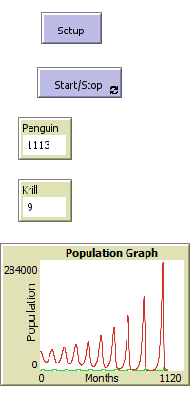
Building the Model
Head back to the model’s main interface. We will now be adding a Monitor for the Penguin and Krill stock. Under Reporter, type Penguin for one and Krill for the other. Set both to have 0 decimal places. Now add a Plot. Title it “Population Graph” and set the x-axis label to “Months” and the y-axis label to “Population”. Change the Pen Name of the first pen to “Penguin” and change the color to anything that will stand out. Add another Pen and name it “Krill”, choose another color. You should now be able to click Setup and Start/Stop to see your model run! You can use the bar at the top of the interface to speed up or slow down the simulation.

Slide 10
Building the Model
Before we add Climate Change as another factor, we need to figure out the relationship between temperature and penguin and krill population. Obviously, warmer temperatures leads to increased habitat loss for both animals, but how exactly can we model this accurately?
Go to the IMBIE website to find the results of their research. Scroll down and download the excel sheet called Data for plotting. Upon opening the file, delete the third and fourth columns, we only need the information on Antarctica. The information provided tells us how much of the Antarctica Ice Cap contributes to an increase in sea level (melted ice increases sea levels) each month. This still does not tell us how changing temperatures influence habitat loss. For that, we will need to look at NASA’s record of global temperatures. Download the data provided.
In the downloaded excel sheet, add a new column called “Temperature Anomaly (° F)”. Starting from 1992 to 2017, add the yearly Temperature Anomalies. Be sure to convert the downloaded data from Celsius to Fahrenheit during this process. Now, use excels Graphing and Trendline features to create an equation that fits the data. We will be using the logarithmic equation as it best fits the model. Because our first two “Antarctic Sea Level Contribution (mm)” values are negative, remove them from the graph. You should end up with a similar equation relating Temperature Anomaly (F) and Antarctic Sea Level Contribution (mm) as shown in the figure.

Slide 11
Building the Model
We can now start adding habitat loss as a factor in our model. Start in the main interface page and create a Slider. Name the Slider “user-Annual-Temperature-Increase”. Be sure to use keyword “user” as it tells the computer that the user can access and modify the Slider. Set the minimum value to 0, the increment to 0.0001, the maximum to 1, the value to 0, and the unit to °F. This will allow our user to test different global warming rates. Now, go back to the System Dynamics Modeler and add a Stock called “BreedingGround”. Set its initially value to 57,000 and do not allow negative values. Research estimates that if the entire Antarctic Ice Sheet melted, it would contribute to an increase in sea level by 57,000 mm. Add another Stock called “TotalTemperatureChange” and set its initial value to 0. Do not allow negative values. This Stock represents the total temperature increase overtime after the simulation has begun. It is equivalent to “Temperature Anomaly (F)”. Now add an in-Flow to “TotalTemperatureChange”. Call it “temperature-change-per-month” and set its expression to “user-Annual-Temperature-Increase / 12”. We need to divide the input value by 12 because our model updates every month rather than every year.

Slide 12


Building the Model
Now we use the equation that we produced earlier. Create an out-Flow out of “BreedingGround” and call it “BreedingGroundLoss”. Use algebra skills to manipulate our equation from earlier so that we isolate “x”. The “x” value tells us how much of our BreedingGround has been lost. The final expression for our Flow should look like this:
The reason we must subtract the second e^… term from the first is because our “x” values represents the total loss in BreedingGround. Thus, if we subtracted “x” from BreedingGround every month, our Stock would not be accurate.
Now that “BreedingGround” is complete, we need to somehow correlate it to the rest of our system. We can do this simply by adding it as a factor of “penguin-birth-rate” and “krill-birth-rate”.
We divide the values by 57,000 because we need “BreedingGround” to represent a ratio. As “BreedingGround” decreases, the birth rate of both animals should decrease proportionally. Before we move back to the interface, do not forget to add all the necessary Links to visually clarify your model!

Slide 13
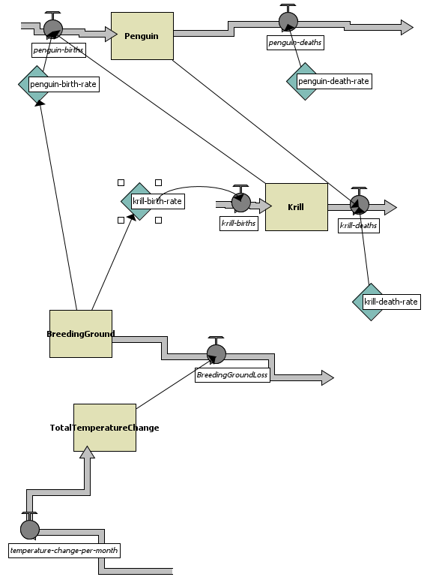
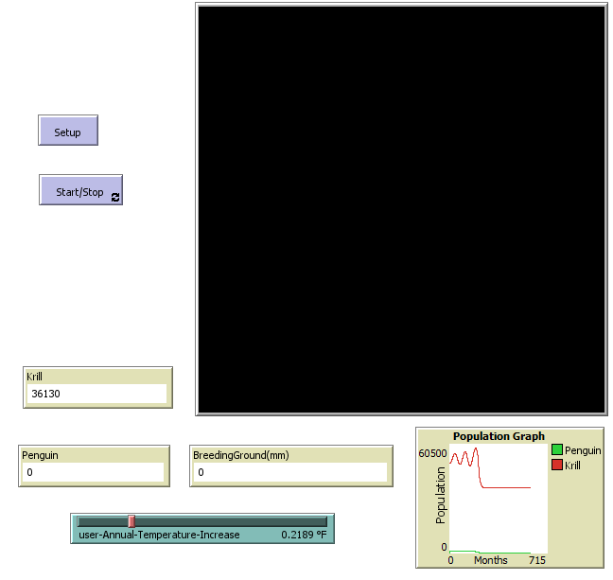
Building the Model
Our last step is to add one more Monitor to our interface. Under reporter, type “BreedingGround”. The monitor will now display this name; however, we can clarify the Monitor by changing its display name to “BreedingGround (mm)”. Set the decimal places to 0. This will allow us to track our “BreedingGround” stock.
Your model is now complete! It should look like below. Start testing your model by adjusting the slider to whatever value you would like and watching the results vary!

